Slide 1






Conduct interpretive activities in the field
D2.TTG.CL3.03
Notes:
Trainer welcomes students to class.

Slide 2

Conduct interpretive activities in the field
This Unit comprises four Elements:
1. Make on-tour preparations
2. Introduce the interpretive activity
3. Conduct the interpretive activity
4. Review the interpretive activity
Notes:
Trainer advises trainees this Unit comprises four Elements, as listed on the slide explaining:
Each Element comprises a number of Performance Criteria which will be identified throughout the class and explained in detail
Trainees can obtain more detail from their Trainee Manual
At times the course presents advice and information about various protocols but where their workplace requirements differ to what is presented, the workplace practices and standards, as well as policies and procedures must be observed.

Slide 3

Assessment
Assessment for this unit may include:
Oral questions
Written questions
Work projects
Workplace observation of practical skills
Practical exercises
Formal report from employer/supervisor
Notes:
Trainer advises trainees that assessment for this Unit may take several forms, all of which are aimed at verifying they have achieved competency for the Unit as required.
Trainer indicates to trainees the methods of assessment that will be applied to them for this Unit.

Slide 4

Element 1 – Make on-tour preparations
Performance Criteria for this Element are:
Implement interpretive activity plans
Schedule the interpretive activity
Prepare on-tour requirements to support the interpretive activity
Confirm operational details with colleagues
Ensure safety issues have been addressed
Provide for maximum engagement by customers
Notes:
Trainer identifies for trainees the Performance Criteria for this Element, as listed on the slide.
Class Activity – General Discussion
Trainer leads a general class discussion by asking questions such as:
What is an interpretive activity?
Why is it necessary to prepare for them?
Who is involved?
What is involved in theoôī process?

Slide 5

Implement interpretive activity plans
Context:
Unit deals with skills and knowledge required to deliver interpretive activities to groups and individual on tour
Does not include the pre-tour research, planning and preparation required to precede the presentation of an interpretive activity in the field
Notes:
Trainer provides context stating:
This unit deals with skills and knowledge required to deliver interpretive activities to groups and individual on tour
It does not include the pre-tour research, planning and preparation required to precede the presentation of an interpretive activity in the field
These topics are addressed in the unit ‘Plan, develop and evaluate interpretive activities’.

Slide 6

Implement interpretive activity plans
Concept of interpretive guiding:
Use of interpretive activities and presentation techniques by a Tour Guide when leading/presenting a tour
Makes a much more memorable experience
Goes beyond the basic provision of information
Refers to use of interpretive activities and techniques to interpret topics/areas
Seeks to make people care about/for topics and subjects which are the focus of interpretive activities
Notes:
Trainer discusses concept of interpretive guiding:
Interpretive guiding can be seen as the use of interpretive activities and presentation techniques by a Tour Guide when leading/presenting a tour
Their use makes a tour for participants a much more memorable experience
Interpretive guiding goes beyond the basic provision of information which is seen by many as their sole objective when conducting a tour
Interpretive guiding refers to the use of interpretive activities and techniques to interpret the topics/areas which are the focus of the tour or encountered along the way
In many ways interpretive guiding seeks to make people care about, and care for, topics and subjects which are the focus of interpretive activities.
Classroom Activity – Internet Research
Trainer oversees research of and discussion on sites such as:
http://www.nps.gov/idp/interp/101/foundationscurriculum.pdf pp 3 - 4 - Foundations of Interpretation: curriculum, content, narrative NPS – Interpretive Development Program: Professional standards for learning and Performance’ (National Parks Service, US Department of the Interior)
http://www.nps.gov/idp/interp/101/processmodel.pdf - The interpretive process model (National Parks Service, US Department of the Interior).

Slide 7

Implement interpretive activity plans
Seven questions to address:
Why is the interpretive activity being conducted?
When is the interpretive activity to be presented?
Where is the interpretive activity to be conducted?
Who is involved in the activity?
How is the interpretive activity to be conducted/presented?
What resources are available to deliver the interpretive activity?
Have necessary permissions to conduct the activity been obtained?
Notes:
Trainer explains Understanding interpretive activity plans is the basis of implementing interpretive activity plans.
In practice there is a need for Tour Guides to obtain answers to seven very important questions:
Why is the interpretive activity being conducted?
When is the interpretive activity to be presented?
Where is the interpretive activity to be conducted?
Who is involved in the activity?
How is the interpretive activity to be conducted/presented?
What resources are available to deliver the interpretive activity?
Have necessary permissions to conduct the activity been obtained?
Classroom Activity – Handouts
Trainer distributes and discusses a range of interpretive activity plans for different types of activities.

Slide 8

Implement interpretive activity plans
Why is the activity being conducted?
Plans need to accommodate a range of factors
Exact nature of plans will:
Vary between tours
Alter over time/with seasons
Differ to reflect special needs/requests
(Continued)
Notes:
Trainer addresses
Why is the interpretive activity being conducted?
Highlighting the individual nature of tours and planning:
When plans were prepared for interpretive activities they traditionally need to take into account a range of different considerations
The exact type/nature of considerations will:
Vary between tours – as the focus and advertised/required content for the tours require
Alter over time and/or as the year progresses – to accommodate seasonal influences and changes
Be different for different tour groups/customers – to reflect any identified special needs/requests.

Slide 9

Implement interpretive activity plans
Need to understand why tour is being conducted to:
Place the tour into its true context
Optimise likelihood of meeting customer expectations
Accommodate feedback received
Discharge legal obligations
Identify subjects which may be the focus of interpretive guiding/activities
Notes:
Trainer continues to address
Why is the interpretive activity being conducted?
Talking about generic issues which need to be understood in order to:
Place the tour to be conducted into its true context – by putting the tour, inclusions and interpretive activities into perspective as this applies to the individual tour
A primary requirement here is to determine if the tour is:
A private/custom tour – see following slides
A standard/scheduled tour – see following slides
Optimise likelihood of meeting customer expectations – in relation to:
Special requests made by customers in relation to the tour – some (but not all) Tour Operators will accommodate certain special requests if they are cost neutral and if they can be fitted in to the time constraints of the itinerary
Inclusions which have been promoted as being part of the tour – in advertisements for the tour as presented in the media, tour brochures and other promotional materials
Accommodate feedback received – from;
Previous tour group members – on the basis of:
Formal written feedback received
Issues raised during the end-of-tour discussion which should be standard for every Tour Group to have with their tour group
Staff who have conducted the interpretive activity on previous occasions
The local/host community
Discharge legal obligations – as imposed by:
Contracts for the tour which have been developed/entered into
Legislation relating to false advertising
Identify subjects which may be the focus of interpretive guiding/activities include:
Flora and fauna
Domestic and farm animals
History and heritage
Culture, arts and entertainment
Sport and recreation
The general natural environment
The built environment
Festivals, seasons and religious observances.
Classroom Activity – Handouts
Trainer distributes and discusses a range of sample itineraries for different tour types.

Slide 10

Implement interpretive activity plans
Private/custom tours:
Developed under contract with a client
Customised on a one-off basis
Designed to meet particular need
Run when required by client
Planned on a tour-by-tour basis
Notes:
Trainer describes/defines
Private/custom tours
Private/custom tours are tours which are:
Developed under contract with a client (individual or group)
Customised on a one-off basis – in terms of:
Focus
Interpretive activities
Commentary
Itinerary
Cost
Inclusions
Designed specifically and totally to meet the stated/identified needs of the individual client
Run at a time and date determined by the client
Planned and prepared/organised on a tour-by-tour basis.

Slide 11

Implement interpretive activity plans
Implementation requirements for private/custom tours:
May be based on implementation requirements for standard tours
Often unique in nature
Requires contact/communication with client
Notes:
Trainer discusses implementation requirements for private/custom tours:
May be based on implementation requirements for standard tours – planning of these tours may have been based around a standard tour for the purposes of efficiency or because scheduled tours cover/address much of the requirements for the private tour
Will often be unique in nature – given the one-off nature of these tours
Can often require contact with the client to:
Confirm requirements
Clarify issues.

Slide 12

Implement interpretive activity plans
Standard/scheduled tour:
Is the normal/regular tour advertised by the business
Available to everyone
Taken by most people
Same itinerary every time
Same interpretive activities every time
Same thing time-after-time
Notes:
Trainer describes/defines
Standard/scheduled tour
A standard/scheduled tour (also known as a ‘regular’ tour):
Is the normal tour advertised generally by the company
Is available to all/members of the public
Is the type of tour most people take
Operates using the same itinerary every time
Features the same interpretive activities, inclusions and scripted commentary every time
Is essentially the same tour for all tour group members, time-after-time – subject to seasonal changes and other foreseeable and unforeseeable factors.

Slide 13

Implement interpretive activity plans
Implementation requirements for standard/scheduled tours:
Features standard preparation and planning
May require checks to determine if special requests have been made
May require adjustment/s to accommodate need to change normal route, commentary, inclusions and/or activities
Notes:
Trainer discusses implementation requirements for standard/scheduled tours:
Is standard – in terms of:
Preparing required resources
Checking usual lists and documentation
Ensuring the same tour delivered previously is replicated this time to maintain quality and consistency of delivery
May require checking to determine if any special requests have been made – and/or are approved or are required by management
May require adjustment – to accommodate the changes (to route, commentary, inclusions, interpretive activities) brought about by seasonal factors.

Slide 14

Implement interpretive activity plans
‘Theme/s and message/s’:
Two terms used interchangeable but are different
‘Message’ is an uncomplicated stand-alone statement which makes sense on its own but underpins and supports the theme for an activity
‘Theme’ is often referred to as ‘the take home message’ for the visitors
(Continued)
Notes:
Trainer talks about theme/s and message/s observing before starting a tour the Tour Guide needs to know about any identified, required or promised themes and messages that tour group members are expecting from the tour as this impacts significantly on how an interpretive activity will be presented.
Trainer notes important points to note regarding ‘theme and message’ are:
The terms ‘message’ and ‘theme’ are often used interchangeably but do have separate meanings
A ‘message’ (sometimes more properly known as an ‘interpretive message’) is an uncomplicated stand-alone but important statement which makes sense on its own but nonetheless underpins and supports the theme for an activity – for example, ‘Modern civilisation can cause adverse impacts on local communities’
The ‘theme’ for the activity (or the tour) is often referred to as ‘the take home message’ for the visitors – the use of the word ‘message’ in this commonly used definition is partly responsible for the confusion that exists regarding distinction between the two terms
The take home message is one, big idea that the tour/activity wants people to leave with/thinking about.

Slide 15

Implement interpretive activity plans
No limit on nature of messages and themes
They are the story-lines for activities
They flow from the name/title of the tour
Can be one or multiple
Notes:
Trainer continues discussing message and theme:
There is no limit to the exact nature of the ‘messages and themes’ which may be developed
‘Messages and themes’ may be seen as the story-lines for activities
They flow from the ‘topic’, title or focus for the tour
There may be a single message or theme, or multiple story-lines, attached to/included as part of an interpretive activity.
Classroom Activity – Internet Research
Trainer oversees research of and discussion on sites such as:
http://www.parks.ca.gov/pages/735/files/InterpPlanningWorkbookWEB2013.pdf - Interpretation Planning Workbook (California State Parks, 2013

Slide 16

Implement interpretive activity plans
When is the interpretive activity to be presented?
Tour Guide needs to view itinerary to determine this in order to:
Get a context for the tour
Identify start time
(Continued)
Notes:
Trainer discusses
When is the interpretive activity to be presented?
The Tour Guide must view the tour itinerary (both the operational and customer versions – to ensure they are in accordance with each other) in order to:
Get a general impression of the overall content of the tour – with reference to:
Complexity
How inclusions and interpretive activities ‘flow’ and fit/integrate with each other given the context of the tour and the type of tour being conducted
Any other relevant issues generated by local conditions, traffic, weather or any other factors likely to impact timing-related issues – such as matters likely to:
Slow travel times
Delay provision of services by other parties
Hinder activities of tour group members
Identify start time for the tour – the time the tour departs. It is important for all tours to start ‘on time’ so:
The timing of all tour activities and inclusions can be adhered to
Arrangements made with other/support third party providers (shops, carriers, entertainers, co-workers, catering) can be honoured – by having tour groups at a given location by a given time.

Slide 17

Implement interpretive activity plans
Identify finish time
Determine sequencing and other timing-related issues and imperatives
Notes:
Trainer continues to discuss
When is the interpretive activity to be presented?
Identify finish time for the tour – the tour must return ‘on time’ because:
There may be a need for the Tour Guide to take another tour at a scheduled/advertised time which is shortly after the return time of the first tour
Tour group members may be expecting to return at a set time and have made arrangements to do other things based on this knowledge/expectation
Failure to return ‘on time’ mat raise unacceptable labour cost issues
Determine timing requirements in relation to the overall tour – with specific attention paid to individual interpretive activities in terms of their:
Sequence in the itinerary – that is, noting how many activities there are and which ones are first, second and so on
When each one is scheduled to start
When each activity is time-tabled to finish
Alternates – that is, identification of possible alternate activities which are provided for (and have been trialled, tested and appropriately approved and resourced) in case the scheduled interpretive activity cannot be presented.

Slide 18

Implement interpretive activity plans
Where is the interpretive activity to be conducted?
Common options:
In the Tour Operator building
On-site
On a tour vehicle
Notes:
Trainer discusses
Where is the interpretive activity to be conducted? Common options are:
Within the Tour Operator building – such as in a purpose built room designed and fitted out to accommodate basic/standard ‘training’ type activities
This room traditionally has tables and chairs, room to move, communication technologies (such as slides, PowerPoint data projectors, DVD player and monitors/screens, microphones, sound systems)
This location may be used for:
Pre-tour briefings and distribution of standard tour-related handouts/materials
Activities designed to get tour group members to know each other
Pre-tour interpretive activities such as workshops, demonstrations, interactive group activities, brainstorming, group discussion, lecture-type presentation, screening of films/DVDs and slides
On-site locations – where interpretive activities are conducted which may be:
In designated outside locations – that is, in the ‘open air’ but at no particular site
At a particular natural site – such as a waterfall, valley, river, viewing point
Within a built structure at a destination – such as within a museum, at a theme park, in a room at a shop or an attraction, at a sports complex
In a local/host community – where arrangements and agreement have been made
On the tour group vehicle – the tour group vehicle is often used for discussions, story-telling, reading handouts, handling (sensory awareness of) materials, lectures, playing games, conducting quizzes, and delivery of scripted commentary. Use of the tour group vehicle as a location for some interpretive activities is common and:
Means many vehicles are equipped with supporting technology to facilitate the activities
Provides activity for tour group members on what can be, otherwise, long and potentially boring travel times – to and from destinations.

Slide 19
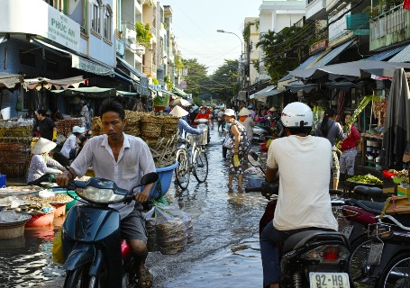
Implement interpretive activity plans
Knowing the location is important because:
It helps prepare mentally
Provides an understanding of travel times
Creates a basis for what is required
Notes:
Trainer explains knowing the location of each interpretive activity is important because:
This knowledge helps provide a mental context for the Tour Guide – it helps the Guides get a feel for the tour and orient the tour locations in their mind
It generates mental impressions regarding travel times to destinations for the activities
Creates an overall impression of what is to be provided – through setting each activity into its individual location and setting.

Slide 20

Implement interpretive activity plans
Who is involved in the activity?
Options/personnel may include:
Staff from the Tour Operator
Members of local communities
Specialists from third party providers
Notes:
Trainer discusses
Who is involved in the activity?
Those who may be involved can include:
Others from within the Tour Operator’s business – such as:
Other Tour Guides
General assistants
Topic/subject presenters or experts
Chefs/cooks
Vehicle drivers
Translators
Security staff
Safety officers
Members of local/host communities – who:
Can be involved in tour guiding roles within their community
May lead/conduct certain interpretive activities such as dance, demonstrations, cooking, artwork, story-telling and song
Specialist personnel from third party providers/organisations – who may provide on-site and/or on-tour:
Translation and interpretation services
Safety and security
Directions and guidance
Catering
Supply and provisioning (food, fuel, goods and services).
Classroom Activity – Guest Speakers
Trainer arranges for several of the people identified above to attend and discuss/describe their role in relation to conducting/assisting with interpretive activities in the field.

Slide 21

Implement interpretive activity plans
Tour Guide needs to know:
Who and how many personnel are to be used
Roles and responsibilities
How their job integrates with other services
Notes:
Trainer explains the Tour Guide needs to know:
Exactly who and how many will be involved with them on the tour and as part of the tour crew
Roles and responsibilities allocated to each person
How their own role integrates with the services to be provided by ‘other personnel’ who are also part of the tour and the interpretive activities to be conducted.

Slide 22

Implement interpretive activity plans
How is the activity to be conducted?
Plans will detail:
Interpretive techniques to be used
Tour and activity communication
Safety and security
Notes:
Trainer discusses
How is the interpretive activity to be conducted/presented?
The plans for the scheduled interpretive activities will detail how each activity is to be conducted.
The Tour Guide will have to obtain instruction/direction from the pre-prepared plans in relation to:
Interpretive techniques to be used:
Role playing; Using different voice techniques; Story-telling; Playing of games; Conducting activities; Presenting demonstrations; Delivering participant interaction situations; Holding sensory awareness exercises; Using materials to enhance illustration and experiences; Utilising technology to assist with delivery; Identifying further links where interested participants can find more information if they want to – when the tour has concluded
Tour and activity communication – Tour Guides need to look at the plans to:
Identify the communication equipment/facilities available and/or required to help delivery of activity information
Determine communication devices to be taken/used by tour staff
Identify the commentary for the tour and each interpretive activity
Safety and security issues – to discharge Duty of Care.

Slide 23

Implement interpretive activity plans
Tour Guides must:
Become familiar with risk management plans for the activity
Learn all applicable risk control measures to be applied
Ensure necessary resources are loaded
Check facilities and arrangements to ensure security
Notes:
Trainer highlights for a Tour Guide this means they need to read the plans which have been prepared to:
Become familiar with the risk management plans developed for the tour and for each activity
Gain familiarity with and a thorough understanding of all applicable risk control measures which are required to be implemented
Ensure all resources necessary to support and implement the required risk controls are loaded onto the tour group vehicle/s or otherwise taken or available for the trip/activities
Check the equipment and/or tour arrangements provide sufficient security to safeguard the staff and people on the tour/participating in interpretive activities and protect all physical assets.

Slide 24

Implement interpretive activity plans
What resources are available to deliver the activity?
Resources will relate to:
Human resources
Physical resources
Financial resources
Notes:
Trainer discusses
What resources are available to deliver the interpretive activity?
Human resources – these are the people will are available to provide assistance/services to the tour and the activities. There will always be specification relating to:
Staff numbers
Hours available to each staff member
Total staff wages for the tour including payments to external providers of services
Physical resources – this relates to the items, materials, products, goods and equipment allocated to each tour and activity
An analysis of requirements relating to physical resources will have been done as part of the planning process and this will have resulted in the development of ‘Loading Sheets’ for each tour and/or interpretive activity
The Loading Sheets specify by type and quantity all the resources which the Tour Guide must take on the tour
All the identified resources need to taken but no additional items can be taken unless management agrees
The Tour Guide may be responsible for:
Physically loading these items onto tour group vehicles
Checking others have correctly loaded the required supplies
Financial resources – the Tour Guide must:
Determine the budgets applicable to the tour and (where applicable) to each interpretive activity – there is a non-negotiable requirement all tours and activities must be accomplished/delivered within the allocated budgets
Identify and obtain the cash they need to take with them when they depart – this money:
May be in local or other currency
Can be used to purchase items, equipment and services while on tour
Is used to pay entry fees
May be used to pay members of local/host communities for their participation in activities
Identify and obtain non-cash payment requisites – such as:
Credit cards
Letters authorising purchase on behalf of the Tour Operator.

Slide 25

Implement interpretive activity plans
Tour Guides need to know ‘available/required resources’ to:
Cross-check requirements against supply
Determine financial parameters/budget
Ensure all required resources are prepared and loaded for the tour/activity
Notes:
Trainer notes Tour Guide must identify resources required and/or available to:
Allow cross-checking of what is required against what is available to support/enable it
Become aware of the financial parameters for the tour and each activity and thus be able to operate the tour and the activities within budget
Make sure all required resources have been loaded/stowed before the tour departs.

Slide 26

Implement interpretive activity plans
Have necessary permissions been obtained?
This may require:
Sighting written evidence of management authorisation
Verifying required permits have been issued
Ensuring agreement from local communities
Confirming compliance with all other requirements under applicable legislation, Codes or arrangements
Notes:
Trainer discusses
Have necessary permissions been obtained?
This may require:
Sighting written evidence management has authorised the tour and the activities t be implemented as described in the plans according to the resources identified/available – or obtaining face-to-face authorisation from management
Verifying permits have been obtained allowing entry to certain areas – where these are necessary
Making sure there is respect for indigenous people by checking to see local/host communities have agreed to (as appropriate):
Allow tours onto their lands/into their communities
Participate in/conduct certain activities
Provide nominated goods and/or services to the tour
Confirming the requirements of all applicable ‘other requirements’ have been/will be met – these considerations may relate to:
Compliance with agreed Codes of Conduct with local/host communities
Alignment with Codes of Practice developed by industry bodies/associations to which the Tour Operator belongs/subscribes
Requirements imposed by the QA scheme used by the Operator.

Slide 27

Implement interpretive activity plans
Ways Tour Guides can learn about planning considerations for a tour/activity are:
Read tour files
Read tour brief
Read tour advertisements
Speak to management
(Continued)
Notes:
Trainer explains standard ways in which a Tour Guide can become aware of the planning considerations for a tour are:
Read tour files – and any planning documentation generated as part of the planning process for the tour
Read the Tour Brief
Read advertisements relating to the tour
Speak to management.
Classroom Activity – Handouts
Trainer distributes and discusses samples of:
Tour files
Tour briefs
Tour advertisements.

Slide 28
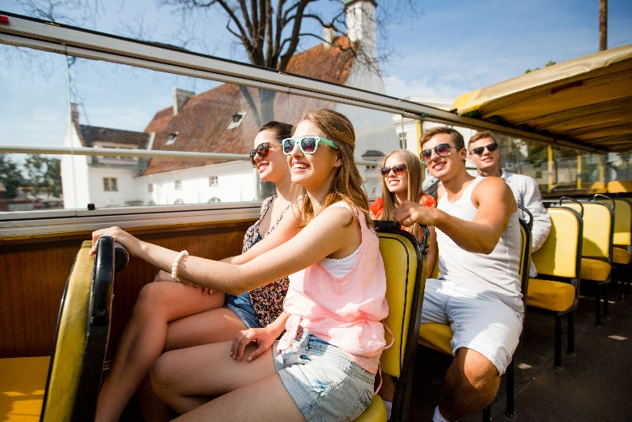
Implement interpretive activity plans
Talk to those who developed the tour
Talk to Tour Guides who have conducted them
Talk with staff who negotiated private/custom tours
Take a tour as a ‘paying customer’
Notes:
Trainer continues to explain standard ways in which a Tour Guide can become aware of the planning considerations for a tour:
Talk to those who prepared/developed or created the tour
Talk to other Tour Guides who conduct the tours
Talk to the person/s within the organisations who negotiated the contract for each private/custom tour – to identify their specific requirements
Take standard/scheduled tour as a tour group member/paying customer – to gain an appreciation of what is required.

Slide 29
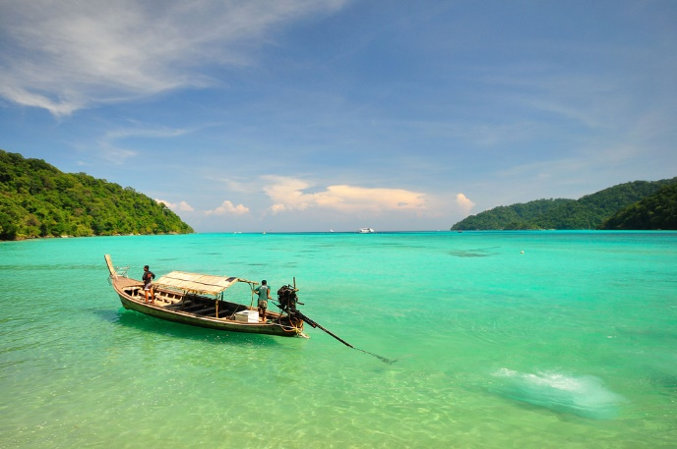
Schedule the interpretive activity
Pre-planning needs to be considered can include:
Consideration of timing
Consideration of weather
Consideration of physical resources
(Continued)
Notes:
Trainer notes before implementing a planned interpretive activity there is a need for the Tour Guide to consider pre-planning needs highlighting these needs will vary between the different types of activities which are to be presented so with this in mind consideration of pre-planning needs may embrace:
Consideration of the timing – to ensure:
The activity is going to be delivered in accordance with the itinerary
Confirmation of the duration of the activity to be presented – which means determining the finish time for the activity
Other activities and inclusions for the tour can be delivered as advertised/promised
Variations to planned timing needs to be made to accommodate/respond to issues arising on tour
Local/host communities are ready to receive the tour group and/or begin their participation in/engagement with the interpretive activity
Consideration of the weather – to:
Make sure it is safe to conduct the activity given the weather conditions which exist at the time
Verify appropriate resources are available to suit the weather conditions which apply at the time
Decide if an alternative interpretive activity needs to be presented instead of the original, planned activity
Determine if the interpretive activity needs to be cancelled due to adverse weather conditions
Consideration of the physical resources – to verify:
Correct/required resources are available to allow the planned interpretive activity to be delivered
Sufficient resources are available and ready to use
The available resources are safe to use
Resources advertised as being available are ready to be used and/or distributed to tour group members
The security of resources to be used and those which are to be left on the tour vehicle
Equipment and items provided by third party providers are safe and suitable for the activity to be conducted.

Slide 30
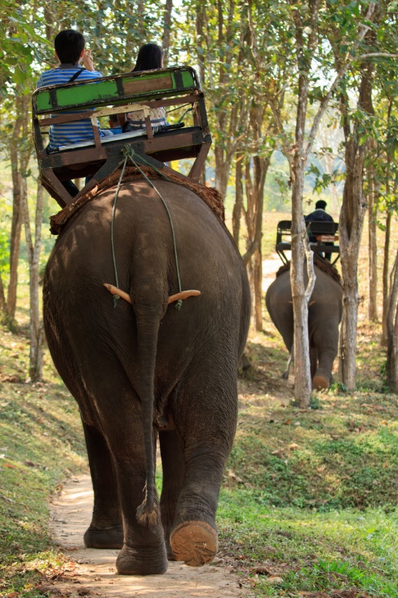
Schedule the interpretive activity
Consideration of personnel
Consideration of tour group members
Consideration of physical environment
Notes:
Trainer continues discussing pre-planning needs with reference to:
Consideration of the personnel – to ensure:
All tour staff understand their role and responsibilities in relation to the interpretive activity
Staff are ready to start the activity
The Tour Guide or the person(s) who will lead/conduct or present the activity is ready to start
Members of the local/host community are ready to play their part
Consideration of the customers/tour group members – to:
Determine their readiness to engage with the interpretive activity
Calculate when and where relevant information about the activity will be communicated to/shared with them
Determine their physical, mental and/or attitudinal capacity or potential to safely engage with the activity
Identify any special requests or requirements which they have made regarding the activity and/or their engagement with it
Consideration of the physical environment – to:
Verify the location in which the interpretive activity is to be conducted
Check the safety and suitability of the location
Confirm the physical environment reflects the physical environment used when the risk management/planning for the activity was undertaken
Demonstrate respect for indigenous people and local communities
Take action to minimise the impact of the interpretive activity on the physical environment.
Classroom Activity – Guest Speaker
Trainer arranges for Tour Guide to attend and:
Discuss pre-planning needs they consider
Explain potential impact of same
Illustrate actions required.

Slide 31

Schedule the interpretive activity
Possible ‘issues arising’ also need to be considered – for example:
Previous interpretive activities running over time
Previous interpretive activities running under time
Need to cancel or in some way amend an interpretive activity
Requests/demands from tour group members
(Continued)
Notes:
Trainer states Tour Guides need to consider ‘issues arising’ during the conduct of the tour when they schedule an interpretive activity observing examples of issues arising can be:
Previous interpretive activities running over time and leaving less time for the next activity
Previous interpretive activities running under time thus leaving more/extra time for the next activity
Need to cancel or in some way amend an interpretive activity because of safety, weather or other reasons
Requests/demands from tour group members for certain things to be done, changed or omitted from the itinerary.

Slide 32

Schedule the interpretive activity
Unacceptable tour group behaviour
Accidents/incidents
Vehicle breakdown or road closure
Sickness/illness in the group
Notes:
Trainer continues with examples of possible issues arising:
Unacceptable behaviour and/or attitudes demonstrated by certain tour group members
Accidents and/or incidents which have occurred when the tour group participated in a previous interpretive activity
Vehicle breakdown and/or road closures which have caused delays to the itinerary
Sickness of tour group members or involvement of participants in an accident of some sort.

Slide 33

Schedule the interpretive activity
Tour Guides need to consider possible issues arising to allow planning/consideration of options to:
Adjust timing if necessary
Adjust activities
Notify relevant others
(Continued)
Notes:
Trainer states reasons Tour Guides need to consider these issues to plan regarding possible actions/options:
To adjust timing of the activity to maintain the itinerary times/schedule
To adjust activities to accommodate the requests and/or competency level of tour group members
To notify other personnel regarding the issues arising and their impact/how they will impact the upcoming interpretive activity.

Slide 34
Schedule the interpretive activity
Integrate new learning/experiences into an activity
Maintain respect for local communities
Optimise safety
Notes:
Trainer continues to state reasons Tour Guides need to consider these issues:
To integrate new learning/experiences into an activity because that learning/experience was unable to be delivered in a previous activity that was cancelled or cut short
To make sure respect for local/host communities is maintained – for example, where a decision may be made to cancel an activity/visit due to unacceptable behaviour/attitudes of a tour group
To optimise the safety of tour group members with reference to whatever issue is deemed to be potentially impacting them.

Slide 35

Schedule the interpretive activity
May also be a need to consider:
Keeping tour on schedule
Meeting budget
Cancelling an activity
Changing the commentary
(Continued)
Notes:
Trainer adds allied issues also need to be considered and these are deemed to be issues which impact on, or flow from, timing of the activity highlighting consideration in relation to scheduling therefore may need to address topics such as:
Keeping the tour on schedule according to the itinerary by (for example) making up time by reducing the duration of this activity – because the previous one ran over time
Ensuring budgetary constraints are always met – which means there is never a situation where a Tour Guide can do ‘whatever it takes’ to resolve or retrieve a situation
Cancelling a scheduled interpretive activity – on the basis of insufficient time or because of the fitness level and/or physical capacity of tour group members
Changing the commentary – so it addresses the changed circumstances and/or activities for the tour.

Slide 36
Schedule the interpretive activity
Checking delayed activities can still be safely presented
Communicating with other stakeholders and updating them
Reviewing/revising the itinerary while on-tour
Making notes for later reference/referral
Notes:
Trainer continues with allied issues:
Checking to make sure a delayed interpretive activity can nonetheless still be presented safely – in terms of available light, weather and the physical condition (tiredness) of the tour group members
Communicating with stakeholders and/or third parties (communities, providers, carriers, destinations, caterers) – and advising the tour will be arriving earlier/later than expected/arranged
Reviewing and revising the itinerary while on tour – by adjusting inclusions and activities in order to finish the tour on time
Taking notes about the situation – so these may be used as the basis for feedback provided by the Tour Guide at the de-briefing session after the tour has finished.

Slide 37
Prepare on-tour requirements to support the interpretive activity
Plans for set-up of activities must be followed because:
They save time
They have been risk assessed
They meet budget parameters
They align with requirements of relevant stakeholders
(Continued)
Notes:
Trainer explains plans prepared for the interpretive activity should be adhered to for the following reasons:
Following the plans decreases the time required for set up – because functional directions and an effective list of preparatory activities in sequence/order will be provided
They have been subjected to standard risk assessment protocols of risk identification, risk evaluation and risk control – and are therefore safe to conduct only ‘as planned’
They will comply with budget constraints imposed by the Tour Operator – regarding labour, physical resources of other expenditure items
The plans may have been developed in collaboration/consultation with certain bodies/people who have insisted or required they be implemented ‘as stated.’

Slide 38
Prepare on-tour requirements to support the interpretive activity
They will optimise safety
They will allocate correct time for each aspect of the set-up
They will maximise likelihood of identified objectives for the activity being achieved
Notes:
Trainer continues explaining reasons to stick to plans for activity set-ups:
Implementation according to the plan ensures compliance with all safety requirements – and Duty of Care obligations
They will have been created to allow ‘the right amount’ of time for each activity – based on its individual type on the basis of trialling, experience and feedback received
Implementation of an interpretive activity according to the plan will optimise the outcomes for the activity – and therefore increase satisfaction levels for tour group members, thereby increasing the potential for return and/or referral business.

Slide 39

Prepare on-tour requirements to support the interpretive activity
Actions in setting-up an activity can involve:
Obtaining resources
Inspecting equipment/items
Obtaining support handouts, materials and other resources
Checking the activity area
Holding a briefing
Notes:
Trainer states setting up an interpretive activity can involve the following generic actions:
Obtaining resources – from:
Tour vehicles
Third party providers
Inspecting the condition of equipment/items – to:
Make sure they are safe
Clean and/or repair items as necessary
Obtaining handout materials, equipment and other physical resources – for:
Distribution to tour group members
Use within the activity
Checking the activity area – to:
Confirm safety issues
Determine appropriate availability of location/s
Holding a briefing – with:
Other Tour Guides and staff from the business
Others from outside the business who will be participating in the activity and/or delivering some aspect of the activity.

Slide 40

Prepare on-tour requirements to support the interpretive activity
Respect for local communities must be shown:
Meeting with the communities and their representatives
Developing Codes of Conduct
Notifying communities in advance
Maintaining regular contact with them
Providing them with economic opportunities
(Continued)
Notes:
Trainer notes at all times the Tour Guide must ensure there is respect shown for local communities explaining practical aspects of this requirement may include:
Meeting with local communities to develop Codes of Practice and other working agreements – in relation to tours and the conduct of interpretive activities
Developing Codes of Conduct – for tour group members who visit local/host communities
Notifying communities in advance – of dates and times of expected tours
Maintaining regular contact with local communities – to obtain their feedback in relation to their experiences with tours so necessary adjustments to Codes and agreements can be made
Providing economic opportunity for local/host communities – in terms of (for example) payment for work on tour-related jobs (guides, entertainers, demonstrators) the provision of retail opportunities (to sell goods and services to the tour group members) and/or the provision of food and beverages.

Slide 41
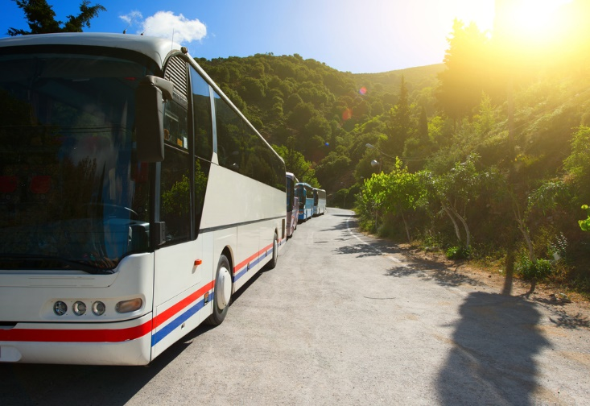
Prepare on-tour requirements to support the interpretive activity
Providing tour advice ‘on the day’ of the tour/activity
Notifying tour group of required behaviour/Codes
Asking permission to enter locations/lands
Observing applicable cultural restraints
Maintaining secrecy of items as required by host communities
(Continued)
Notes:
Trainer continues to identify ways to demonstrate respect for local communities:
Advising the communities on the day (or the day before) the tour – so they receive a reminder of the tour and receive updated information about numbers, special requests and other relevant matters
Notifying tour group members of acceptable and unacceptable conduct – see later information
Asking permission to enter lands/communities – every time a tour or activity is conducted on their land or in their community
Observing the necessary cultural constraints – as required by different communities and cultures
Maintaining secrecy of items and information – as requested by the local/host community.
Classroom Activity – Guest Speaker
Trainer arranges for a representative from a local community to attend and:
Discuss their requirements in relation to tours and interpretive activities
Provide sample Codes of Practice applicable to their community
Illustrate with reference to examples their experience with tour groups
Make recommendations for positive relationships between tour operators and local communities.

Slide 42

Prepare on-tour requirements to support the interpretive activity
Involving local community in decision making
Parking tour vehicles only in designated areas
Staying on identified walking tracks
Prohibiting taking of photographs (if applicable)
(Continued)
Notes:
Trainer continues to identify ways to demonstrate respect for local communities:
Involving the local/host community in decision making which impacts them – so decisions/activities are never imposed on them against their will
Parking only in designated areas – as prescribed by the communities
Staying on designated walking tracks and agreed pedestrian routes – as opposed to walking ‘anywhere and everywhere’
Prohibiting taking of photographs – of certain areas or of people.

Slide 43

Prepare on-tour requirements to support the interpretive activity
Banning use of scarce/limited resources
Prohibiting carriage of nominated items into the communities
Cleaning up after each visit/activity/tour
Modifying tours and activities on the basis of feedback from the community
Notes:
Trainer continues to identify ways to demonstrate respect for local communities:
Banning use of limited/scarce local resources – such as water
Identifying and banning carriage of nominated items/products onto community lands/property – this ban may be on fast food, newspapers, bottles, disposable nappies/diapers
Cleaning up after using facilities – or a ban on using facilities
Modifying tours and interpretive activities – on the basis of feedback received from the local communities.

Slide 44

Prepare on-tour requirements to support the interpretive activity
Preparing tour group for the activity can require:
Making a verbal presentation
Assessing customer capacity to participate
Distributing items
(Continued)
Notes:
Trainer advises another important aspect of preparing to deliver an interpretive activity is the need to prepare group members for the activity stressing this can involve:
Making a verbal presentation – explaining the activity and detailing what tour group members:
Can expect
Will be expected to so
Might think about when engaging with the activity
Assessing individual capacity for individual members to participate in the activity – in terms of (as appropriate) their:
Age
Height and weight
Physical fitness
Previous experience
Stated unwillingness/reluctance to participate
Distributing materials, resources and/or equipment – which tour group members will/might:
Read to gain background knowledge about the activity
Use to engage in a practical way with the activity
Provide instructions, directions, tips, advice and suggestions to optimise engagement with and enjoyment from the activity.

Slide 45

Prepare on-tour requirements to support the interpretive activity
Demonstrating use of items
Advising of basic operational parameters for the activity
Notifying tour group of acceptable/unacceptable behaviour
Introducing others who will assist during/as part of the activity
Encouraging engagement with the activity
Notes:
Trainer continues to identify ways to prepare tour members as part of preparing to deliver an interpretive activity:
Demonstrating use of items required in relation to the activity – this may involve showing how to:
Wear or use safety clothing and protective items
Use tools and/or sporting equipment
Achieve whatever may be the aim/objective for the activity
Notifying tour members of basic operational parameters – in terms of (as applicable):
Start and finish times
Safety issues
Physical/geographical parameters relating to the activity
‘Do’s’ and ‘Don’ts’ for the activity
Notifying tour group members of acceptable and unacceptable conduct – in terms of topics such as:
Language
Behaviour
Taking of photographs/videos
Engaging with community members
Cultural sensitivities particular to individual communities
Introducing other people who will be helping to deliver the presentation – such as:
Third party guides or interpreters
Members of the local/host communities
Encouraging tour group members to engage with the activity – by:
Motivating them through anecdotes and personal enthusiasm
Identifying the potential benefits and learning they may take from the activity
Offering ongoing help and support for them while they participate.
Classroom Activity – Guest Speaker
Trainer arranges for an experienced Tour Guide to attend and:
Talk about their job and their role
Give advice on conducting interpretive activities in the field
Explain in detail the preparation/organisation they undertake prior to a tour/conducting an activity
Provide sample materials/handouts relevant to their job.

Slide 46

Prepare on-tour requirements to support the interpretive activity
There can be a need to keep preparation activities for an activity ‘secret’ from tour group members in order to:
Align with requirements/directions in the plans
Minimise unwanted/intrusive noise and distraction
Keep people unaware of what is about to happen
Protect certain confidential and private aspects of the activity
Avoid unwanted interruptions from tour group members
Notes:
Trainer states in some cases there can be a need for the Tour Guide to keep the preparation for activities secret from tour group members highlighting this may need to be done to:
Align with directions provided in the plans for an interpretive activity – as part of the SOPs for the activity
Minimise noise which may adversely impact on enjoyment of tour group members – especially in relation to them sleeping or trying to concentrate on (for example) a DVD, the commentary, or another activity
Keep them unaware of exactly what is planned for them – so the interpretive activity can be revealed as a surprise to excite them
Protect confidentialities – regarding preparation activities and/or materials or sources used
Avoid interruptions and distractions caused by unwanted attention and interference from participants – as they look at the procedures and engage in conversation with the Tour Guide.

Slide 47

Confirm operational details with colleagues
Background to this step:
All colleagues scheduled to be part of the activity must be present
The meeting must be scheduled
Plans for the activity must be the basis of the briefing
Meeting should occur in private without tour group members listening
(Continued)
Notes:
Trainer provides background detail in relation to confirming operational details of interpretive activities with colleagues:
All colleagues must be present to have details confirmed – this means internal staff (staff directly employed by the Tour Operator) as well as external staff (those employed from third party providers and/or from local/host communities)
The confirmation needs to be scheduled – there should be a meeting or briefing scheduled for a certain time at a given location and this must be communicated sufficiently in advance to enable all required persons to attend
The plans prepared for the activity must be the basis of the confirmation – and all staff should have a hard copy of their own for reference purposes
Many staff will write notes on their personal copy to highlight tasks they need to focus on and/or pay special attention to
The meeting/briefing should take place in private – that is, it is traditionally not an event the tour group members have access to.

Slide 48

Confirm operational details with colleagues
All those involved should have had previous/relevant exposure to/contact with the activity
Tour Guide leads the discussion
There must be two-way communication
Notes:
Trainer continues to give background to this stage:
All persons with roles to play should already have had exposure to the interpretive activity before this stage take places – that is, everyone involved should have been provided with required training and trialling of the activity to gain first-hands, hands-on experience
Discussion must be led by the Tour Guide or the person who has been delegated directed control of the individual interpretive activity – their primary role (subject to ‘Content’ below) is provide information, confirm arrangements and notify changes
The session must feature two-way communication – where colleagues are encouraged to ask questions to clarify issues and confirm matters about which they may have some concern or reservation.

Slide 49

Confirm operational details with colleagues
Generic contents/topics for this meeting:
Roll call
Overview of the activity
Confirmation activity can/should proceed
(Continued)
Notes:
Trainer indicates while the nature of each briefing/information session prior to an interpretive activity will be unique (based as it will be on the delivery of a particular activity), there are nonetheless several common issues which will require coverage – these include:
Roll call – this is done to:
Ensure all required staff are present as required
Cross-check staff present against planned/expected names and numbers
Confirm role allocation for the activity
Allow Tour Guide to meet and appraise all workers
Provision of an overview of the activity – this involves:
Making sure everyone has a copy of the plan
A read-through of the goals and objectives for the activity
Description of relevant matters for the activity – which can include:
Themes and messages
Special requests
Presence of VIPs on the tour
Changes to be factored in – due to, for example, need to shorten or extend the activity
Focussing everyone’s mind on the up-coming activity
Confirmation the activity should proceed – according to risk management protocols – see later slides.

Slide 50

Confirm operational details with colleagues
Discussion of duration
Development of strategies/confirmation of plans to deal with issues arising
Allocation of staff to roles/responsibilities
(Continued)
Notes:
Trainer continues to provide examples of generic content/topics for this stage of the preparation process:
Discussion of duration for the activity – which may relate to:
Confirmation of a scheduled starting time
Confirmation of a scheduled finishing
Verification with others that timing is appropriate
Notification of revision/s to scheduled starting and finishing times
Development and/or confirmation of arrangements to address issues arising – these may be regarding matters to do with:
Modifications to the standard activity imposed as a result of changes to the location where the activity is to be conducted
Maintenance of safety and security where a legitimate need to change standard actions has emerged
Amendments deemed appropriate to alter the duration of the activity in order to maintain the overall itinerary/schedule for the tour
Required revisions to accommodate special requests
Changes brought about by the need to modify proceedings for certain budgetary reasons
Alterations deemed prudent based on feedback obtained from the tour group while on-tour – in order to better meet their expectations and optimise their level of satisfaction
Allocation of staff to required positions – this will generally be a matter of:
Confirming the arrangements described in the plans and tested during the role playing/trialling for the activity
Adjusting staff allocation based on special needs of individual tour group members which have materalised on-tour and/or been advised at the commencement of the tour
Checking staff allocated to certain positions can comprehensively recite their role while in those positions
Confirming with relevant personnel there are sufficient staff in position at each location to enable required activities to be undertaken as expected
Ensuring, where required by legislation or internal operational protocols, staff used at certain locations:
Hold necessary credentials/certification
Have required experience.

Slide 51

Confirm operational details with colleagues
Verification of presence of physical resources to enable the activity
Conduct of communication checks
Notes:
Trainer continues to provide examples of generic content/topics for this stage of the preparation process:
Verification of the presence of physical resources – including (as appropriate to the type of activity):
Handouts and paper-based materials for distribution
Food and beverages
Basis requisites – such as note pads, pens, sun hats, umbrellas
Technology and devices for self-tours
Playing/sports equipment
Emergency equipment – see next section
Safety clothing and equipment, where necessary – see next section
Conduct of communication checks – to verify full operational status of equipment and devices to be used to:
Communicate between each other
Make contact with other/third party providers
Communicate with tour group members.
Classroom Activity – Excursion
Trainer arranges for class to participate in a tour featuring interpretive activities so they can:
Gain first-hand experience of tours and activities
Observe occurrences and work of tour staff
Talk with tour staff
Obtain handout materials
Observe tour group members and their reactions to activities and interactions with tour staff.

Slide 52

Ensure safety issues have been addressed
Context:
Safety must be a standing topic at all briefing sessions
Safety is paramount and can never be compromised, assumed or ignored
Formal risk assessment for each activity must form the basis of safety
Staff should be asked to confirm/query safety for the activity to be conducted
(Continued)
Notes:
Trainer provides context stating in relation to safety issues associated with the conduct of interpretive activities:
Safety must always be a standing topic for all staff briefing sessions prior to interpretive activities – safety must always be addressed
It can never be assumed or ignored
Safety is paramount – Tour Guides must not do anything which compromises the safety of tour group members, members of the public or staff in any way. If there is a concern about safety, the activity must be:
Delayed until the issue can be effectively/safely resolved
Halted all together /not conducted at all
Replaced by another activity where safety can be guaranteed
The risk assessment conducted as part of the planning stage for the activity must form the basis for safety check – this will commonly require specific mention of mandatory check points identified as part of the risk management process (for example: rain, heat, wind, ground condition, tour group numbers, crowds), together with:
A statement by the Tour Guide that each factor appears within acceptable parameters
A question asking colleagues to confirm or disagree with the above statement
The point being the decision to proceed with safety with the activity must be a consensus decision and not one simply imposed by the Tour Guide – the decision to proceed must be verified/supported by other colleagues.

Slide 53

Ensure safety issues have been addressed
Some activities have a Safety Officer who has total control over safety
Always a need to consider Participants, Environment and Resources
The aim must always be to create ‘safe place’ as opposed to ‘safe person’
Notes:
Trainer continues to give context for safety:
A designated Safety Officer is used for some interpretive activities – and they have total control over safety issues and decisions regarding safety
There are traditionally three standard elements which need to be considered in relation to safety for interpretive activities – these are:
Participants – this means there can be a need to make sure tour group members are safe to engage with the activity and do not put themselves or others at risk. For example:
People who do not meet certain pre-notified (weight or height, general fitness) criteria may be prohibited
Those who are too tired or intoxicated may be banned
Environment – highlights condition of environment may render an otherwise safe activity, unsafe. For example:
High winds may mean conditions are unsafe
Heavy rain in adjacent districts can cause the potential for floods
Changes to the expected nature of the location/environment – this may mean (for example):
Safety equipment normally available is no longer available
A new risk not previously identified, assessed and controlled has emerged
Resources – this means there is a need to consider/ensure:
Sufficient and suitable physical resources to maintain safety – see following slides
Proper human resources to supervise and undertake necessary safety-related activities – see following slides
Physical resources to respond in the event of an emergency – see following slides
The aim of all safety checks is to ensure ‘safe place’ is created instead of creating ‘safe person’ – this means:
Creating environment where safety of people is not dependent on them being safe/doing the safe or right thing
Ensuring that whatever participants do or fail to do, their safety is guaranteed by virtue of the safety protocols built into the place/location in which they are functioning.

Slide 54
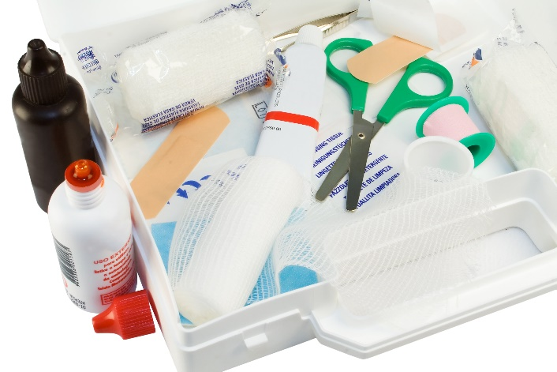
Ensure safety issues have been addressed
Safety-related checks need to ensure:
Emergency equipment identified in risk control protocols is available
Emergency management plans are available
First aid kits are available
Access to retrieval, rescue and/or recovery gear
Presence of effective communication equipment to raise alarm and/or summon assistance
Notes:
Trainer presents safety-related checks need to ensure:
Emergency equipment identified as part of the risk management process for the activity is available as identified
Emergency Management Plans are available
Presence of nominated first-aid kits
Availability of or access to necessary retrieval, rescue and recovery equipment
Presence of communication equipment to raise alarm and/or summon additional assistance.
In some cases the presence of designated fire-fighting equipment/resources may be seen as a necessary element of emergency equipment.
Classroom Activity – Handouts
Trainer distributes and discusses sample Emergency Management Plans for interpretive activities and/or tours.

Slide 55
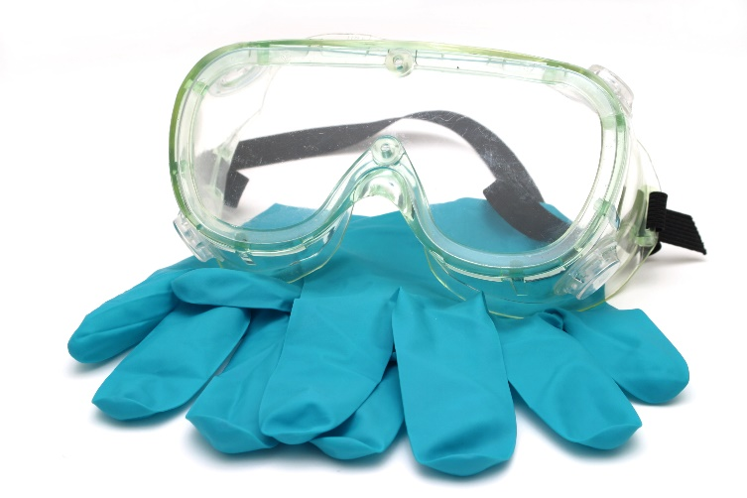
Ensure safety issues have been addressed
Safety equipment:
Known as PPE
Used to prevent harm/injury
Is the responsibility of the Tour Guide to:
Provide PPE for the group
Check items before distribution/use
Ensure tour group members use/wear PPE as required
Notes:
Trainer advises
Safety equipment is often known as PPE (personal protective equipment and clothing)
The intention of PPE is to prevent harm/injury
It is the responsibility of the Tour Guide/Tour Operator to:
Provide appropriate PPE for the group
Check all PPE to be used (whether belonging to the Tour Operator or to individual tour group members) prior to use
Ensure all participants use/wear PPE as required.

Slide 56
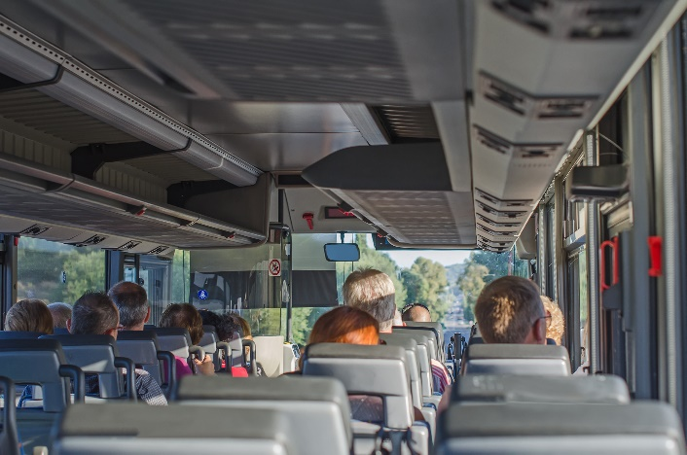
Ensure safety issues have been addressed
PPE:
Is required for all customers and staff
Must be appropriate to the activity
Must address other risk identified as part of the general tour
Notes:
Trainer continues to discuss PPE stating it is required/provided for all tour group members (and staff) – in order to:
Enable them to participate in scheduled activities, sports, events, games and other inclusions
For example when conducting white water rafting or kayaking there would be a need to provide high-visibility life jackets/PFD, safety/white water helmets, knee and elbow pads, whistles, rescue ropes, rescue rope throw bags, neoprene booties, white water knives, padded gloves
Protect them from naturally occurring harm (including sunburn) when on-tour.
Classroom Activity – Excursion
Trainer arranges for students to visit a Tour Operator who conducts interpretive activities so students can:
View facilities
Talk to management and staff/Tour Guides
Observe departure of tours
Inspect PPE used by the organisation for the interpretive activities they conduct
Gain experience on what items are used, when and why they are used and how to use them
Learn checks made on PPE to ensure it is safe to use and will fit/accommodate needs of tour group members.

Slide 57
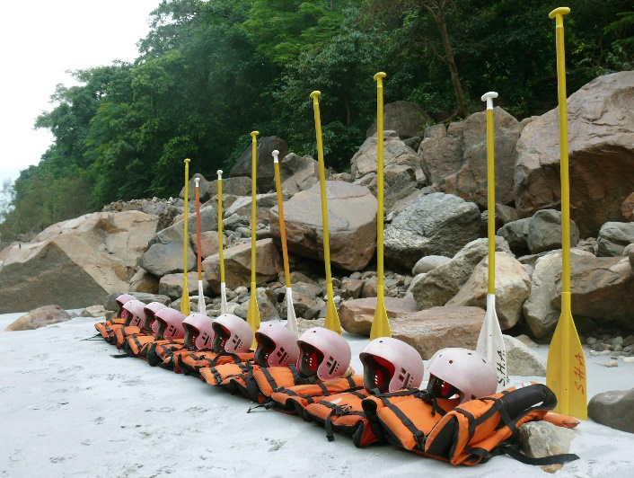
Ensure safety issues have been addressed
Checks of PPE must ensure:
Items align with EMP and/or risk control protocols
Items are available in required numbers and sizes
Gear operates/functions as intended
Items are safe to use
Notes:
Trainer explains checks of PPE must ensure:
Equipment is available in the sizes listed in the EMP
Items are available in the numbers specified
Gear is operating as required
Items are safe to use.

Slide 58

Ensure safety issues have been addressed
Checks on human resources in relation to safety must ensure:
Staff are suitable for allocated roles
Sufficient staff are available
Rescue/recovery staff are available (where required)
Qualified first-aid staff are present
All safety elements of risk management plans and EMPs can be handled
Notes:
Trainer discusses checks on human resources in relation to safety must be made to ensure:
Suitable staff to conduct safety briefings and demonstrations with participants – see following slides
Sufficient staff are present to enable effective supervision of activities
Appropriate staff are present to undertake rescue, retrieval or recovery if necessary
Qualified staff to deliver first-aid in the event an accident or incident occurs
Capable employees to implement all listed requirements of all relevant EMPs for the activity to be conducted.

Slide 59

Ensure safety issues have been addressed
‘Security’ checks often accompany safety checks to ensure security of:
Property of tour group members
Assets/property of the Tour Operator
Local/host community
The environment
Notes:
Trainer states as part of the check to ensure safety it is common for a security check to follow to ensure the security of:
Customer property and/or company assets during the activity to protect against accidental loss, theft or damage – this may require:
Placing valuables into a designated locked cabinet/safe
Locking items on the tour vehicle
Use of security staff
Removal of certain items from people while they are participating in the activity
Activation of security systems
Local/host community – to protect them from:
Identified threats – as identified by the host people
Unintentional intrusion into their private lives
Illegal activities
Unacceptable language and behaviour
The environment – in terms of:
Minimising impact
Avoiding foreseeable negative impact
Removing rubbish
Minimising use of scarce local resources.

Slide 60

Provide for maximum engagement by customers
It is always necessary to maximise engagement of tour group with an activity because:
This is why they have joined the tour and paid their money
Higher levels of engagement mean higher levels of satisfaction – which leads to increased repeat and referral business
Notes:
Trainer explains it is always critical to maximise engagement by tour group members with every interpretive activity because:
This is why they have paid to be part of the tour – they will have chosen the tour (or the individual activity) because they have a definite interest in the interpretive activity which was advertised/promised
Higher levels of engagement mean higher levels of customer satisfaction which, in turn, leads to:
Increased rates of referral business – where those who have enjoyed their tour/the activity will tell others (their family, friends and colleagues) thereby referring them to the same tour/activity
Greater likelihood of return/repeat business – where previous tour group members will:
Join another tour conducted by the Tour Operator because they were impressed with the first one
Come back and re-take a tour/activity they previously did simply because it was so enjoyable.

Slide 61

Provide for maximum engagement by customers
Providing for maximum engagement of tour group members at the preparation stage can involve:
Unloading items from the tour vehicle/s
Obtaining required resources from third party providers
Ensuring sufficient equipment
(Continued)
Notes:
Trainer suggests at the preparation stage, providing for maximum engagement by participants may need to consider:
Unloading items from the tour vehicle – together with:
Completing visual and other checks to confirm suitability
Counting and recording items
Obtaining identified resources from third party providers – as previously arranged:
In accordance with purchase orders
To align with individual requirements – for example:
Specific activity requirements
Agreements regarding economic opportunity for local community
Ensuring sufficient equipment – for all participants:
In-keeping with the plan for the activity
In accordance with their individual need and personal characteristics
To achieve objectives imposed by last-minute special requests.

Slide 62

Provide for maximum engagement by customers
Taking action to address issues/missing items
Locating items/resources in required positions
Planning the positioning of tour group members
Notes:
Trainer continues suggesting ways to maximise engagement in the preparation phase:
Arranging for action to address missing/broken items – such as:
Buying additional items
Borrowing items
Adjusting the activity
Positioning of items in the most appropriate position – which may require attention to:
Initial distribution of items at the participant briefing/demonstration
Placement of items at different locations/stations along the way
Maintaining security of items until they are used/required
Planning for the positioning of customers – with reference to, as appropriate:
Initial briefing/demonstration
Practice session/s
Key stages within the activity.

Slide 63

Summary – Element 1
When making on-tour preparations:
Obtain and read the activity plans
Clarify details about the group and the activity
Realise the success of the activity hinges on effective planning and preparation
Match planning and preparation to the identified needs of the group
(Continued)
Notes:
Trainer provides a recap of the Element asking questions to check trainee understanding and responding to questions from trainees, as required.

Slide 64

Summary – Element 1
Focus on the message/s, the theme/s and the objectives
Acknowledge the activity is part of a wider, total package
Determine the time and location for the activity
Identify those who will assist in conducting/delivering the activity
(Continued)
Notes:
Trainer provides a recap of the Element asking questions to check trainee understanding and responding to questions from trainees, as required.

Slide 65

Summary – Element 1
Stay within budget
Choose an appropriate presentation technique
Organise all necessary resources
Schedule the activity in accordance with all applicable agreements and arrangements
(Continued)
Notes:
Trainer provides a recap of the Element asking questions to check trainee understanding and responding to questions from trainees, as required.

Slide 66

Summary – Element 1
Set up for the activity in accordance with plans for the activity
Respect local communities
Prepare all required resources to reflect identified requirements
(Continued)
Notes:
Trainer provides a recap of the Element asking questions to check trainee understanding and responding to questions from trainees, as required.

Slide 67

Summary – Element 1
Liaise with others to confirm their roles and responsibilities
Make safety a prime consideration for every activity
Optimise customer engagement with the activity to increase enjoyment and satisfaction
Notes:
Trainer provides a recap of the Element asking questions to check trainee understanding and responding to questions from trainees, as required.

Slide 68
Element 2 – Introduce the interpretive activity
Performance Criteria for this Element are:
Alert people to the up-coming interpretive activity
Welcome customers to the interpretive activity
Explain the interpretive activity
Demonstrate necessary pre-requisites for the activity
Confirm customer understanding regarding the up-coming activity
Notes:
Trainer identifies for trainees the Performance Criteria for this Element, as listed on the slide.
Class Activity – General Discussion
Trainer leads a general class discussion by asking questions such as:
What is involved in introducing an activity?
Why is this an important aspect of delivering/conducting an interpretive activity?
How might this be done?
Who is likely to be involved?
Where might this process occur?

Slide 69

Alert people to the up-coming interpretive activity
It is essential to alert tour group members about up-coming activities in order to:
Meet their expectations
Generate excitement and anticipation
Get people talking
(Continued)
Notes:
Trainer emphasises making participants aware of all up-coming interpretive activities is essential in order to:
Meet expectations – they expect to be made aware of what is happening
Generate excitement and a sense of anticipation – which enhances enjoyment of the tour
Get people talking – about the imminent event.

Slide 70

Alert people to the up-coming interpretive activity
Keep people informed about what is happening
Allow individuals to prepare personally
Give a chance for questions to be asked and/or special requests to be made
Notes:
Trainer continues explaining need to alert tour group members to up-coming activities – in order to:
Keep people informed – to let them know how the tour is progressing in terms of the itinerary they have been given
Allow individuals to prepare – on a personal basis, which may be:
Getting ready
Making a ‘comfort stop’
Checking their camera
Having something to eat and drink
Changing clothes/footwear
Give them an opportunity to:
Ask questions
Lodge special requests
Read handout material.

Slide 71
Alert people to the up-coming interpretive activity
Common ways to alert tour group members to an up-coming activity:
Including activities on the itinerary
Identifying activities as part of pre-tour briefing
Making verbal activity-specific announcements
(Continued)
Notes:
Trainer states common ways to alert tour group members to up-coming activities are:
Including them on the itinerary – and:
Making sure everyone receives a copy of the itinerary when they are issued with their ticket
Posting a copy of the itinerary in the camp or in the tour vehicle
Identifying the activities as part of the pre-tour briefing – which may be conducted:
At a special event shortly before departure day (for extended tours)
On the day of departure before departing the Tour Operator’s business
Making verbal group-based announcements – which may be made:
Along the way/route of a walking tour
At rest or meals stops/breaks
On the tour vehicle
At end-of-day sessions (for multiple day tours)
At briefing sessions at the start of each day (for multiple day tours).
Classroom Activity – Demonstration
Trainer demonstrates how to alert tour group members to an up-coming interpretive activity.

Slide 72
Alert people to the up-coming interpretive activity
Advising of basic details regarding the activity
Encouraging engagement
Responding to questions and concerns
Speaking to/following up with individuals on a one-to-one basis, if required
Notes:
Trainer continues to identify common ways to alert tour group members to up-coming activities:
Advising of the details of the of the activity – which will involve:
Describing the physical/geographic location of the activity
Identifying about timing – start and finish times
Notifying of any necessary changes which have to be made – together with explanation of cause/reason
Encouraging engagement – which can include:
Motivating people to attend or watch
Highlighting the benefits of participation
Setting challenges
Stressing the unique nature of the activity/experience
Responding as appropriate – to:
Questions
Concerns
Fears
Issues arising
Speaking to people on an individual basis – to:
Ensure all group members are aware of up-coming activities
Show interest in individuals
Optimise likelihood of responding positively to all concerns/matters raised.
Classroom Activity – Role Plays
Trainer arranges for students to demonstrate role of Tour Guide to alert tour group members about up-coming interpretive activities.

Slide 73
Welcome customers to the interpretive activity
Standard requirements/protocols for ‘The Welcome’ for an activity are:
Every activity should feature a formal/prepared ‘Welcome’
It must be a spoken/verbal welcome identifying the activity, creating anticipation and providing relevant context
They should be relatively brief
(Continued)
Notes:
Trainer states when welcoming tour group members to an interpretive activity the activities below are standard practices:
There is a welcome for every interpretive activity – where there are multiple activities each activity must be given its own welcome because:
They are different/unique – no two (at least on the same tour) should be identical although they may be similar
They are each an important part of the total package bought by the customer and deserve their own introduction
There is a need to provide activity-specific detail and information in order to enhance and illustrate the activity
There must be an actual spoken welcome – which must:
Identify the location/the physical location of the activity
Identify the activity – by name and/or type and/or title
Demonstrate enthusiasm for what is about to be presented
Provide relevant background information to the activity
Give a suitable context for the activity
Link this activity to any previous activities which have similarity/relevance
The welcome should be relatively short – it needs to happen but:
It must not dominate
It should not unnecessarily delay.
Classroom Activity – Demonstration and Practice
Trainer demonstrates how to welcome tour group members to an interpretive activity and provides an opportunity for students to do the same.

Slide 74

Welcome customers to the interpretive activity
Relevant materials are distributed
Codes of Conduct are explained
Staff are introduced
Notes:
Trainer continues presenting standard practices regarding The Welcome for an activity:
Provision of relevant materials appropriate to the site and/or activity – such as:
Notes and handouts; Information sheets and brochures; Maps; Samples; Snacks; Name tags
Presentation of site-specific Code of Conduct – with which all tour group members are expected to comply highlighting, describing and illustrating:
Acceptable and unacceptable behaviour
Acceptable and unacceptable language
Rationale for same
Consequences of failing to comply
Introducing other staff who will assist the Tour Guide – in terms of:
Providing advice to tour group members
Demonstrating requirements to participants
Supervising and controlling the overall activity or particular aspects of it
Specialist roles and responsibilities.
Classroom Activity – Handouts
Trainer distributes and discusses examples of materials which may be distributed to tour group members at the start of an interpretive activity.

Slide 75

Welcome customers to the interpretive activity
Some activities use ‘recorded’ welcomes – these:
Remain the same for all tours for all groups
May be audio and/or video
Can incorporate explanations, demonstrations and safety
Require the group to be assembled to listen/see the recording
Should be supplemented by a ‘live’ face-to-face session
Notes:
Trainer explains some tours and activities feature the use of recorded ‘welcomes’ and these:
Are standard video and/or audio welcomes shown at the start of nominated activities – to all tours/tour group members
May incorporate other aspects of the activity also – such as:
Explanations of activities
Demonstrations of practice
Identified risk associated with the activity
Safety issues
Will require tour group members to be assembled – so they can gain optimum information from them, either:
On the tour vehicle
In a room
Should be supplemented by a face-to-face ‘live’ session – which:
Allows additional information to be provided
Enables questions to be answered.
Classroom Activity – Demonstration
Trainer obtains sample recorded welcome for an interpretive activity from a local Tour Operator/venue and:
Plays it to the students
Describes its context and application
Facilitates discussion on its use/suitability.

Slide 76

Explain the interpretive activity
Practicalities of explaining an interpretive activity:
Often done when demonstrating the activity
Can be part of ‘The Welcome’
Tour group need to be suitably assembled
Amplification (megaphone or PA) may be suitable/required
(Continued)
Notes:
Trainer advises practicalities in relation to explaining an interpretive activity are:
In many cases the presentation of this section is undertaken at the same time as ‘demonstrations’ for the activity – as described in later slides
In some cases the ‘Welcome’ (refer previous slides) also includes an explanation of the activity – as well as demonstration of necessary pre-requisites
Care must be taken to ensure correct positioning of tour group members and presentation staff – so:
Everyone can hear what is said
All can see what is done
Amplification of explanations may be acceptable (or necessary) – where this:
Does not negatively impact local amenity
Does not intrude on the enjoyment of others.

Slide 77

Explain the interpretive activity
Presentation must reflect plans/planning
Explanations must align with/support previous information provided
Linkages should be made to previous activities
Must cover relevant practical training (where required)
(Continued)
Notes:
Trainer continues to advise practicalities in relation to explaining an interpretive activity:
Presentation must reflect the plans for the activity – in terms of:
What is said
Sequence of information
Individual roles and responsibilities of staff conducting the explanation
Training undertaken for this part of the activity
The explanation must be in accordance with previous information provided about the activity – as presented, for example:
In advertisements and promotions for the tour/activity
In contracts for the tour
On itineraries
At previous briefings/advisory sessions
During earlier discussions
Linkages should be made to previous activities – with reference to:
Experiences
Lessons learned
New thoughts/perspectives gained
Explanations must always include training for the activity – with reference to:
Demonstrations – see following slides
Practice
Tips and advice for optimising mastery/competency
Rules of the game
Objectives of the activity.

Slide 78

Explain the interpretive activity
Needs to ‘long enough’ but not ‘too long’
May require repetition/s and/or paraphrasing of what has been presented
There is a need to check understanding of what has been explained/presented
(Continued)
Notes:
Trainer continues to advise practicalities in relation to explaining an interpretive activity:
Need to pay attention to the time spent on explanations – which means:
There needs to be ‘sufficient’ explanation
The explanation must never dominate or steal time from the actual activity
Explanations must never be padded out
There can be a need for repetition of explanations – with attention paid to perhaps:
Repeating what has been said
Paraphrasing – saying the same thing but using different words
Checking for understanding – through a combination of activities as described in section 2.5.
Classroom Activity – Demonstration
Trainer demonstrates how to explain an interpretive activity to tour group members.

Slide 79

Explain the interpretive activity
May require/benefit from involvement of others in the presentation
Includes need to identify associated risks
Must address action to take in the event of incident, accident or emergency
Notes:
Trainer continues to advise practicalities in relation to explaining an interpretive activity:
Willingness to use other tour group members to help with explanations – where:
This is appropriate
More experienced persons appear ready to assist less experienced ones
Highlighting risks associated with the activity – in terms of:
Type and timing
Location
Management and control
Potential impact
Action to take in the event of certain eventualities – such as:
Difficulty
Danger
Incident and accident
Changed circumstances/weather
Becoming lost/separated from group.
Classroom Activity – Role Plays
Trainer arranges for students to demonstrate role of Tour Guide in explaining interpretive activities to tour group members.

Slide 80

Demonstrate necessary pre-requisites for the activity
Demonstrating necessary pre-requisites may involve/require:
Implementing approved plans
Distributing equipment
Integrating explanations with demonstrations
Using tour team/staff to conduct a model/simulated activity
(Continued)
Notes:
Trainer observes demonstrating necessary pre-requisites will/may involve:
Implementing approved plans for demonstration of the interpretive activity – according to:
The individual activity
Site factors/constraints
Training, role plays and drills in this regard
Distributing equipment – such as:
Handing out items
Naming the items
Describing their use
Integrating explanations with demonstrations – so:
Understanding is optimised
There is a seamless delivery of information
Safety is a constant thread
Using the tour team to conduct a simulated/model activity – to:
Show how to undertake the activity
Demonstrate tips and techniques
Highlight certain aspects of the activity (as appropriate to the individual nature of the activity) such as:
Teamwork
Speed
Skill levels
Observation of the environment/happenings
Interpretation of data, evidence or material
Application of the rules
Alignment with outcomes.

Slide 81

Demonstrate necessary pre-requisites for the activity
Using standard practice for demonstrations
Walking the activity ground
Distributing activity-specific items
(Continued)
Notes:
Trainer continues presenting information on demonstrating necessary pre-requisites for an interpretive activity:
Focussing on the standard presentation technique for demonstrations – which includes:
Demonstrating at normal speed what needs to be done with no explanation whatsoever
Then demonstrating slowly/step-by-step with explanations at each stage – perhaps asking participants what the next step is and/or why the next stage needs to occur
Asking people to join in – and practice/demonstrate the activity along with/at the same time as the Tour Guide
Providing time for practice – with supervision and assistance in order to generate some level of competency
Building on known previous knowledge
Walking the activity ground (for certain activities only) – which means:
Physically walking around the activity ground/site
Pointing to dangers/risks – and highlighting the actions/controls which are inherent to prevent accident or injury
Providing specific techniques which may be useful at different points of the activity
Highlighting location of safety equipment, rescue gear and/or emergency equipment
Indicating where Safety Officers will be positioned – and how people can/should gain their attention/contact them
Distributing activity-related items if required – together with:
Providing Instructions and/or directions
Explaining rules for games or activities
Linking use of items to objectives/intended outcomes.

Slide 82
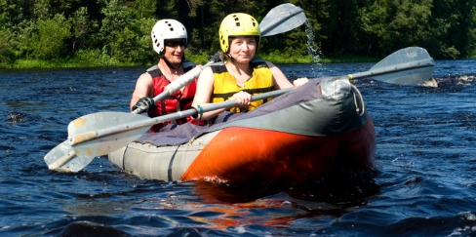
Demonstrate necessary pre-requisites for the activity
Distributing safety equipment
Showing how to use equipment
Showing use of PPE
(Continued)
Notes:
Trainer continues presenting information on demonstrating necessary pre-requisites for an interpretive activity:
Distributing safety equipment, if required – including:
Naming items – and important parts of same
Explaining and demonstrating use of same
Indicating why and when items are required
Highlighting location of items during the activity
Showing how to use equipment – which should cover:
Demonstrating how to use games equipment
Illustrating use of activity-specific items
Linking safety to use of equipment and items
Showing use of PPE – in terms of:
Demonstrating how to wear necessary safety clothing
Helping tour group participants put on/correctly wear protective clothing
Demonstrating how to use personal safety items
Helping individuals achieve basic competence in use of personal safety items.
Classroom Activity – Demonstration
Trainer demonstrates how to demonstrate necessary pre-requisites for an interpretive activity to tour group members.

Slide 83

Demonstrate necessary pre-requisites for the activity
Showing how to use emergency equipment
Employing use of ‘sufficient’ personnel to assist
Allocating ‘sufficient’ time
Notes:
Trainer continues presenting information on demonstrating necessary pre-requisites for an interpretive activity:
Showing how to use emergency equipment – with attention paid to:
Indication of triggers for implementing use of same
Explanation/illustration of role of customers and role/s of tour staff in the event of an emergency
Identification of available items
Specification of location of emergency equipment
Employing the services of ‘sufficient’ personnel – to:
Speed up the process
Facilitate the process of demonstration
Give enough options for all customers to look at and learn from
Allocating sufficient time for the demonstration/s – such that:
Safety is optimised
The activity is never unnecessarily delayed
Understanding of requirements is confirmed
Proportionality is maintained – that is:
It is more important safety is covered where identified risks exist than is the case where no genuine risks have been identified
Serious things deserve serious treatment.
Classroom Activity – Role Plays
Trainer arranges for students to demonstrate role of Tour Guide in demonstrating necessary pre-requisites for interpretive activities to tour group members.

Slide 84

Confirm customer understanding regarding the up-coming activity
Reasons to confirm understanding:
Helps to discharge Duty of Care obligations
Helps optimise safety
Helps to generate engagement with the activity
(Continued)
Notes:
Trainer explains there are several important reasons to ensure tour group members understand explanations and demonstrations relating to an up-coming interpretive activity:
It helps demonstrate discharge of the common law Duty of Care – and thus helps protect staff and the business against legal action
It helps optimise safety for everyone – which must always be the primary consideration regardless of all other factors
It generates increased involvement/engagement with the activity – and so optimises the twin potentials for increased levels of customer satisfaction and sense of achievement.

Slide 85
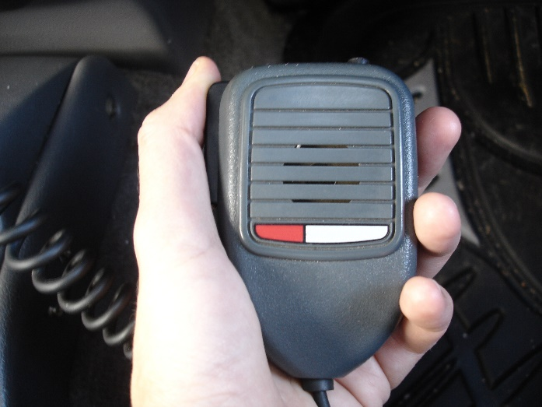
Confirm customer understanding regarding the up-coming activity
Provides (another) opportunity for people to ask questions
Provides (another) chance for people to become familiar with what is required
Increases likelihood of learning
Underlines potential for accident/injury thereby focussing people’s minds on the activity
Notes:
Trainer continues explaining reasons to ensure tour group members understand explanations and demonstrations relating to an up-coming interpretive activity:
It allows an opportunity for people to ask questions – and further clarify issues or ambiguities
It provides (another) chance for users to gain familiarity with what is required – and increase their personal level of mastery/competence
It increases the likelihood participants/tour group members will learn from the experience – or achieve one or more of the identified objectives for the activity
It underlines the potential for accident and injury – and thereby focusses the mind and attention on the activity.

Slide 86

Confirm customer understanding regarding the up-coming activity
Keys when confirming understanding are:
Never safe/sufficient to assume everyone understands what is presented
Extra staff should be used where there are large tour numbers
Strategies contained in approved plans must be the strategies used
There may be a need to obtain signatures on ‘Voluntary Assumption of Risk’ forms
Notes:
Trainer presents keys to remember when confirming understanding are:
it is never sufficient to present information and/or demonstrations – and simply assume (or hope) tour group participants will automatically understand what is required
Use additional staff to assist in the process where there are significant numbers in the tour group – as this will speed up this part of the activity
The confirmations/checks prescribed in the plans for the activity must be the primary strategies used – supplemented by other options
There can sometimes be a need to obtain signatures on ‘Voluntary Assumption of Risk’ documents – to acknowledge the risks/danger and try to absolve Tour Operator from legal action in the event of accident or injury.
Classroom Activity – Handouts
Trainer distributes and discusses sample ‘Voluntary Assumption of Risk’ forms

Slide 87

Confirm customer understanding regarding the up-coming activity
Options for confirming understanding:
Asking questions
Administering some form of ‘test’
Checking individual people
(Continued)
Notes:
Trainer stresses it is best to use a combination of techniques (rather than one, single approach) to confirm tour group member understanding of an activity noting options include:
Asking questions – to check knowledge and/or understanding
Administering a basic ‘test’ – which may be:
A verbal informal assessment
A written test – usually brief in nature such as ‘True’ or ‘False’, or ‘Select the correct response’
A practical test – which can cover:
Use of safety/emergency equipment
Implementation of basic/standard procedures
Checking of individual customers – in terms of:
Physically checking the items of equipment each person is going to use
Physically checking the fit and wearing of safety clothing
Asking people to move/function within their safety clothing
Posing individual tests/trials for people
Eligibility criteria.

Slide 88

Confirm customer understanding regarding the up-coming activity
Encouraging the group to ask questions/seek clarification or more detail
Providing additional guidance and explanation
Monitoring the verbal and body language of individuals
Notes:
Trainer continues to identify options for confirming understanding:
Encouraging customers to ask questions – by:
Asking for questions
Responding politely and positively to them
Thanking those who ask them
Providing additional guidance and explanation – as deemed necessary based on:
The nature of the question asked
The degree of confusion/misunderstanding which appears to be present
The threat/danger posed by the person not knowing the relevant information – this highlights not all information is ‘critical’: some is simply ‘nice to know’
Monitoring people actively to judge levels of understanding – by:
Reading their body language
Interpreting their facial expressions
Listening to what they say and how they say it.

Slide 89
Summary – Element 2
When introducing the interpretive activity:
Advise tour group members of upcoming activities
Distribute information and materials about the activity
Create excitement and expectation
Encourage questions about the activity
(Continued)
Notes:
Trainer provides a recap of the Element asking questions to check trainee understanding and responding to questions from trainees, as required.

Slide 90

Summary – Element 2
Prepare a formal welcome to the activity
Explain relevant details, context and objectives
Demonstrate requirements
(Continued)
Notes:
Trainer provides a recap of the Element asking questions to check trainee understanding and responding to questions from trainees, as required.

Slide 91

Summary – Element 2
Provide an opportunity for tour group members to practice, where necessary
Check physical capability of participants
Emphasise safety
(Continued)
Notes:
Trainer provides a recap of the Element asking questions to check trainee understanding and responding to questions from trainees, as required.

Slide 92

Summary – Element 2
Distribute and demonstrate use of PPE
Address emergency protocols
Verify participants understand what is required
Notes:
Trainer provides a recap of the Element asking questions to check trainee understanding and responding to questions from trainees, as required.

Slide 93

Element 3 – Conduct the interpretive activity
Performance Criteria for this Element are:
Assemble tour group as required
Provide commentary and interpretive presentation techniques
Apply appropriate interpersonal skills
Use prepared aids and materials and equipment to support presentation
Encourage audience participation, where appropriate
(Continued)
Notes:
Trainer identifies for trainees the Performance Criteria for this Element, as listed on the slide.

Slide 94

Element 3 – Conduct the interpretive activity
Respond to questions
Respect environmental, cultural and social sensitivities
Adjust presentation to suit emerging requirements
Liaise with colleagues throughout the activity
Deal with unexpected events
Complete the activity
Notes:
Trainer identifies for trainees the Performance Criteria for this Element, as listed on the slide.
Class Activity – General Discussion
Trainer leads a general class discussion by asking questions such as:
What is involved in conducting/presenting an interpretive activity?
What experience do you have in relation to this?

Slide 95
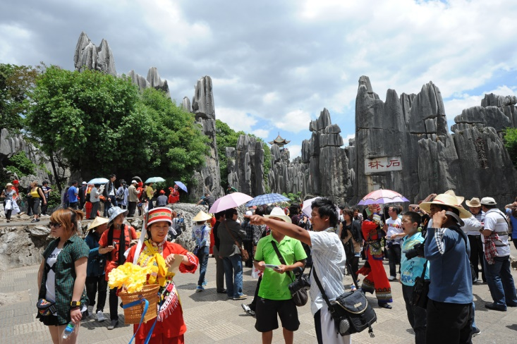
Assemble tour group as required
Standard protocols regarding assembly of tour group:
Check personal requisites before convening the group
Group assembly must flow from (if not actually be part of) the explanation and demonstration phase
All the group should be assembled
(Continued)
Notes:
Trainer indicates standard on-tour protocols regarding assembly of the tour group are:
Check personal requisites before convening the group – this means:
Double-checking own items and equipment before starting the assembly
Verifying items and equipment of staff who are to participate before starting the assembly
It is very unprofessional to assembly the group and then have to delay events while employees get ready
This also does not engender faith/confidence in tour personnel
Group assembly must flow from (if not actually be part of) the explanation and demonstration phase – it is incorrect to believe:
These are separate and distinct ‘stages’ to the introduction and commencement process – rather they should be seen as blending into one seamless ‘pre-activity undertaking’
There are required timelines for any of the actions mentioned – some will be quite brief while others can be expected to take considerably longer. Strive to maintain the itinerary for the tour/activity
All the group should be assembled – where possible/appropriate or time-effective
Time can often not be spent ensuring absolutely everyone is present
There must always be a requirement for ‘the greatest good for the greatest number’ which may mean repeating introductory remarks to those who missed them.

Slide 96

Assemble tour group as required
Proper planning and preparation should precede the assembly
A logical location/assemble must be selected
Tell them what you’re going to tell them, Tell them and then Tell them what you’ve told them
(Continued)
Notes:
Trainer continues to indicate standard on-tour protocols regarding assembly of the tour group:
The assembly of the group should occur with some planning – which may be:
After all necessary explanations and demonstrations have been completed
Once all handouts/distributions have taken place
Following confirmation (as appropriate) that all tour group members understand what is required
At the same location and at the same time as explanations and demonstration are performed
Conduct the assembly at a logical point – this is/may be:
Dictated by common sense and experience
Stated in the plans for the activity
Governed by the size of the group
Determined by the weather and/or existing conditions
Influenced by safety concerns
Impacted by agreements/arrangements with the host/local community or the venue/operator where the activity is being conducted
Follow the standard lecture/training dictum when assembling the group – which is:
Tell them what they are going to be told – the Introduction
Tell them – The Body
Tell them what they have been told – repeat/recap things: the Conclusion.

Slide 97

Assemble tour group as required
Be assertive when convening the assembly
Create and maintain anticipation
Notify all relevant others the assembly is about to start/is occurring
Notes:
Trainer continues to indicate standard on-tour protocols regarding assembly of the tour group:
Be assertive when directing the group to assemble – which means:
Not being aggressive
Giving clear directions
Organising individuals/groups
Speaking loudly enough to be heard
Maintain and/or create atmosphere and anticipation – through:
Choice of words and phrases used
Personal orientation and/or enthusiasm
Encouraging (as appropriate):
Competition between people
Commitment
Willingness to try/participate
Notify relevant others at this stage – there can be a need at this point to:
Update Head Office of progress
Inform the local/host community
Tell third party providers about timing.

Slide 98

Provide commentary and interpretive presentation techniques
Providing commentary and using interpretive presentation techniques is activity-dependent – meaning it/they will:
Depend on the nature/type of activity
Vary between Tour Guides and their personal style
Change based on identified needs of the group
Need to reflect adverts about the tour/activity
Be relevant to the activity
Be chosen to benefit the group
Notes:
Trainer explains providing commentary and interpretive presentation techniques is very much an ‘individual’ consideration meaning it/they will:
Depend on the nature and context of each interpretive activity – an approach totally satisfactory for one activity will be totally inappropriate for another
Vary with the unique character and style of the individual Tour Guide – the approach that suits one Tour Guide will not suit another
Have to change based on the known needs, wants and preferences of the tour group members – and, commonly, their demographic profile
Need to reflect advertisements about the tour and/or activity – in order to meet customer expectations and avoid disappointment
Be necessarily relevant to the activity – and the theme, messages, objectives and context for the activity
Must be applied sensitively for each activity – this means their application must be for the benefit of the tour group members and not (just) for the benefit/pleasure of the Tour Guide or other tour staff.

Slide 99

Provide commentary and interpretive presentation techniques
Commentaries:
All tours have them but not all activities have them
Commentaries may be ‘scripted’ or ‘unscripted’
A scripted commentary is pre-prepared and usually approved by management
Tour Guides traditionally memorise their scripted commentaries
Unscripted commentary normally needs to be added to the scripted commentary for every activity
Notes:
Trainer discusses provision of commentaries stating:
All tours will require some form of commentary
Not all interpretive activities will
Commentary may be described as:
Scripted
Unscripted
A scripted commentary is a prepared talk about identified topics of interest to a group of tour group members
The scripted commentary may be prepared by the Tour Operator and provided for use by the Tour Guide, or there may be a need for every Tour Guide to develop their own scripted commentary for each group they lead and for every interpretive activity they conduct
A scripted commentary should be thought of as a guide about what needs to be said rather than a complete list of everything that needs to be said during an activity
In many cases, experienced Tour Guides will memorise the scripted commentary for regular/scheduled tours and interpretive activities
Unscripted commentary refers to the situation where information is provided to the tour group throughout the activity but reference is not made to a script when doing so
There will always be a need to provide some unscripted commentary to supplement whatever scripted commentary is prepared.
Classroom Activity – Handouts
Trainer distributes and discusses sample scripted commentaries for interpretive activities.

Slide 100

Provide commentary and interpretive presentation techniques
Basic communication strategies to deliver commentaries:
Ensure visibility to tour group members
Face the group
Speak loud enough to be heard
Remain enthusiastic
(Continued)
Notes:
Trainer presents basic communication strategies which can/should be used to deliver commentaries:
Ensuring visibility to all tour group members – it is preferable if all people participating in the activity can also read/see the lips of the Tour Guide when they are speaking but at a minimum they should at least be able to see the person speaking to some extent
Facing the group – to the greatest extent possible
Speaking loudly enough for everyone to hear – or using technology/amplification to help project the voice
Remaining enthusiastic and appropriate to the nature and content of the activity – and appropriate to the nature/profile of the tour group members: some groups/topics require a sombre approach and others a lively and engaging demeanour.
Classroom Activity – Guest Speaker
Trainer arranges for an experienced Tour Guide to attend and:
Describe preparation for delivering commentaries
Provide sample scripted commentaries
Demonstrate delivery of commentaries.

Slide 101

Provide commentary and interpretive presentation techniques
Begin sufficiently ‘in advance’ of the activity/event OR deliver on-site?
Focus on all the group
(Continued)
Notes:
Trainer continues to present basic communication strategies which can/should be used to deliver commentaries:
Beginning the verbal commentary sufficiently in advance of a scheduled event – so participants have time to focus on whatever is the focus of the commentary
Alternatively a decision may be taken to arrive at a stop/location, and then deliver all the commentary at this point – timing constraints will often dictate which option needs to be used, as will the mood/response of the tour group
Focussing attention on entire group – the commentary must be directed at, and embrace, all the tour group members Never fall for the common traps of:
Talking only to those who are closest
Directing commentary at those in the immediate line-of-sight
Commentating only to one or two ‘special’ group members
Focussing on a certain person, age group, nationality or gender.

Slide 102

Provide commentary and interpretive presentation techniques
Speak at a level suitable for the audience
Seek feedback throughout
Encourage questions
Make the commentary a ‘unique event’
(Continued)
Notes:
Trainer presents basic communication strategies which can/should be used to deliver commentaries:
Communicating at level that will be understood by the audience considering their age, education, language, culture and special needs – this frequently means:
Keeping things simple
Using hand gestures to accompany verbal communication
Using appropriate words, terms and phrases
Highlighting points identified as being of interest to the group
Seeking feedback from the group throughout the commentary:
Can they hear/see?
Anything else they want to know?
Do they want a break/rest?
Encouraging questions – and responding to demonstrate questions really are encouraged and appreciated
Making the commentary a ‘unique’ event – avoid allowing commentaries to:
Become boring and lifeless
Sounding rote and mechanised/robotic
Adding comments which include new information and target the interests of the group.

Slide 103

Provide commentary and interpretive presentation techniques
Know when to be quiet
Adjust commentary as required
Notes:
Trainer presents basic communication strategies which can/should be used to deliver commentaries:
Knowing when to be quiet – many people who deliver commentaries seem to think their job is to talk ‘all the time’ and this is definitely not the case/requirement. It is important to keep quiet to allow participants to:
Have a break from being talked at/to
Experience the activity/tour in relative peace and quiet
Enjoy the experience on their own
Think
Adjusting the commentary as required – to accommodate:
Identified interest of the group
Emerging events.
Classroom Activity – Role Plays
Trainer presents students with model scripted commentaries for certain interpretive activities and gives them opportunity to practice presenting them to nominated types of tour groups.

Slide 104

Provide commentary and interpretive presentation techniques
Role plays:
Tour staff and/or tour group members act out designated roles
Used to gain insight and personal experience
Allows people to practice responses to situations
Usually followed by a de-briefing
May be taped for later review or to be given as a memento of the activity
Notes:
Trainer discusses using/application of interpretive presentation techniques
Role playing
Role playing
Involves prescribed situations where tour group members or tour staff act out nominated roles and scenarios – in order to:
Give or gain a sense of engagement and reality to various topics
Experience a set of circumstances
Practice responses to a hypothetical situation
Commonly a de-briefing sessions with discussion/s and informed input from the Tour Guide follows these activities
The role plays may be filmed for inclusion in a video/DVD provided to customers at the end of the tour.
Classroom Activity (1) – Internet Research
Trainer oversees research of and discussion on sites such as:
http://www.nps.gov/idp/interp/103/103mod.pdf - Preparing and presenting and interpretive talk (National Parks Service: US Department of the Interior)
http://www.nps.gov/idp/interp/210/210mod.pdf - Prepare and present an effective conducted activity (National Parks Service: US Department of the Interior)
http://www.nps.gov/idp/interp/220/220mod.pdf - Prepare and present an interpretive demonstration or other illustrated program (National Parks Service: US Department of the Interior).
Classroom Activity (2) – Demonstration and Practical
Trainer demonstrates the interpretive presentation technique identified on the slide (or arranges for an experienced Tour Guide to do so) and then provides opportunity for students to do the same.

Slide 105

Provide commentary and interpretive presentation techniques
Voice techniques:
Add interest, reality and flavour
May include talking faster/slower, louder/softer or pausing
Can put a Tour Guide ‘into character’
Allows use of local names, terms and pronunciations
Demonstrates local accents and dialects
Notes:
Trainer discusses using/application of interpretive presentation techniques
Voice techniques
Different voice techniques:
Will add interest to the tour and to a commentary
They include:
Speaking faster or slower
Pausing/stopping and allowing silence/a pause in the commentary
Speaking louder/shouting or speaking more quietly/whispering
Voice techniques can also include:
Putting a Tour Guide ’in character’ when discussing a certain person/individual
Using local names, terms and pronunciations
Using local dialects and accents.
Classroom Activity – Demonstration and Practical
Trainer demonstrates the interpretive presentation technique identified on the slide (or arranges for an experienced Tour Guide to do so) and then provides opportunity for students to do the same.

Slide 106

Provide commentary and interpretive presentation techniques
Story-telling – can be used to:
Illustrate or make a point
Contribute personal anecdotes
Pass on myths and legends
Add interest and diversity
Notes:
Trainer discusses using/application of interpretive presentation techniques
Story-telling
Story-telling:
Can be used to:
Illustrate a point or make a point
Contribute personal anecdotes
Pass on a myth or legend
Add interest and diversity.
Classroom Activity – Demonstration and Practical
Trainer demonstrates the interpretive presentation technique identified on the slide (or arranges for an experienced Tour Guide to do so) and then provides opportunity for students to do the same.

Slide 107

Provide commentary and interpretive presentation techniques
Games, activities and sports:
Played by tour staff and/or with or between tour group members
Provide fun and action
Give first-hand learning experiences
Notes:
Trainer discusses using/application of interpretive presentation techniques
Games and activities
Games (which can include playing sport/s):
Feature tour group member participation and as a result of their engagement they:
Have fun
Learn something
Experience something new.
Classroom Activity – Demonstration and Practical
Trainer demonstrates the interpretive presentation technique identified on the slide (or arranges for an experienced Tour Guide to do so) and then provides opportunity for students to do the same.

Slide 108

Provide commentary and interpretive presentation techniques
Demonstrations:
Are very popular activities
May be observed by group who learn by watching
Can be complex involving participation in the demonstration by tour group members
Will require commentary to explain
Should always precede any activity where tour group is asked to perform a skill
Notes:
Trainer discusses using/application of interpretive presentation techniques
Demonstrations
These are popular interpretive activities. They may:
Be straight-forward demonstrations – where a skill is demonstrated to the group, and the group do not participate apart from observing
Feature group action – where the tour group practices the skills being demonstrated
Include descriptions/commentary as part of the demonstration
Precede an activity where tour group members have to perform a skill.
Classroom Activity – Demonstration and Practical
Trainer demonstrates the interpretive presentation technique identified on the slide (or arranges for an experienced Tour Guide to do so) and then provides opportunity for students to do the same.

Slide 109
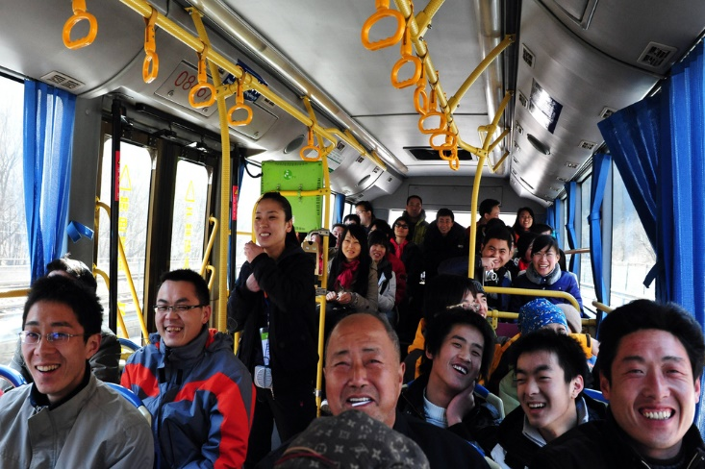
Provide commentary and interpretive presentation techniques
Participant interaction - may:
Require group to interact with each other
Require interaction with a host community
Require interaction with the environment or a situation
Be followed by a de-briefing session
May be taped for later use/distribution
Notes:
Trainer discusses using/application of interpretive presentation techniques
Participant interaction
Participant interaction:
Features activities where members of the tour group:
Interact with each other
Interact with members of a community
Interact with the environment, situation or location
A de-briefing and discussion session usually follows the activities so participants can compare experiences and share experiences
This activity may also be filmed/taped or photographed for inclusion in an end-of-tour DVD/video or set of photos.
Classroom Activity – Demonstration and Practical
Trainer demonstrates the interpretive presentation technique identified on the slide (or arranges for an experienced Tour Guide to do so) and then provides opportunity for students to do the same.

Slide 110

Provide commentary and interpretive presentation techniques
Sensory awareness exercises:
May involve smelling items/food
May involve taste testing
May include feeling items/weights
Commonly features discussion and sharing of personal thoughts and/or comparison with other opinions
Notes:
Trainer discusses using/application of interpretive presentation techniques
Sensory awareness exercises
These are exercises where people are able to (for example):
Smell ‘the roses’ or the coffee, or other items relevant to the theme of the tour
Taste food and beverages
Feel textures, temperatures and weights
Discussions, analysis and personal comparisons and thoughts may accompany the experience or participants may be encouraged to experience the exercise in solitude and reflect on their own orientations.
Classroom Activity – Demonstration and Practical
Trainer demonstrates the interpretive presentation technique identified on the slide (or arranges for an experienced Tour Guide to do so) and then provides opportunity for students to do the same.

Slide 111

Provide commentary and interpretive presentation techniques
Use of materials:
Used to enhance illustration and experiences
May feature use of:
Local product/s
Visual aids
Support materials
Prop kits
Notes:
Trainer discusses using/application of interpretive presentation techniques
Use of materials
The use of materials:
Is a commonly applied interpretive activity to enhance illustration and experiences
Materials may feature the use of:
Local product/s
Visual aids
Support materials
Props/prop kits.
Classroom Activity – Demonstration and Practical
Trainer demonstrates the interpretive presentation technique identified on the slide (or arranges for an experienced Tour Guide to do so) and then provides opportunity for students to do the same.

Slide 112
Provide commentary and interpretive presentation techniques
Use of technology:
Involved in most activities to some extent
May involve use of:
Audio-visual equipment
Sound and lighting technologies
A range of systems and technologies
Notes:
Trainer discusses using/application of interpretive presentation techniques
Use of technologies
Use of technology to assist with delivery:
Is increasingly common in all tour types and with nearly all tour activities
It may require/include:
Audio-visual equipment
Sound and lighting technologies
Systems and equipment designed to optimise safety and/or comfort.
Classroom Activity – Demonstration and Practical
Trainer demonstrates the interpretive presentation technique identified on the slide (or arranges for an experienced Tour Guide to do so) and then provides opportunity for students to do the same.

Slide 113

Apply appropriate interpersonal skills
Ways to optimise the interpretive activity experience for individuals:
Using humour when talking with people (at appropriate times)
Checking on people’s welfare
Applying suitable interpersonal and communication skills at every opportunity/exchange
Involving members of the group in what is happening
Notes:
Trainer informs ways to optimise the interpretive activity experience for individuals can be:
Using humour when talking with people – most tours or activities contain an element of fun and the use of appropriate humour at appropriate times can set the scene for fun and actually impart fun and enjoyment as part of the experience
Checking on people’s welfare – by:
Asking if they need anything
Verifying they are OK and prepared
Helping them
Applying suitable interpersonal and communication skills at every opportunity/exchange – such as:
Smiling and using eye contact
Demonstrating interest
Responding to questions
Clarifying information
Involving members of the group in what is happening – this can include:
Telling them what is about to happen
Providing them with advice of some sort to enable them to move forward with their learning, experience or whatever is the focus of the activity.

Slide 114

Apply appropriate interpersonal skills
Techniques to build rapport with participants:
Extending/building on conversations when people were initially greeted
Asking participants questions
Using icebreakers
(Continued)
Notes:
Trainer discusses building a good rapport stating:
Good rapport-building costs nothing but does require some effort
It is necessary to enhance visitor experience of their tour/activity.
Trainer presents techniques to build rapport with participants may include:
Extending/building on conversations when people were initially greeted– such as:
Remembering and using the person’s name
Mentioning something talked about as part of the previous contact
Checking to ensure something they queries earlier has been resolved to their satisfaction
Asking participants questions – about topics such as:
Their country of origin
Personal interests and specific interests for this tour
Their reasons for being on tour
Their previous experiences and tours
Using icebreakers – these are quick exercises which can be used to ‘break the ice’ and introduce tour group members to each other at the start of a tour or activity. They are really only suitable where:
The participants do not already know each other – if the group members already know each other then ice-breakers are often not appreciated and many resent having to participate in them
There is sufficient time to conduct them – they can be quite time consuming
A suitable, comfortable location exists to do them – standing in the heat is not a good location.
Classroom Activity – Internet Research
Trainer oversees research of and discussion on sites such as:
http://insight.typepad.co.uk/40_icebreakers_for_small_groups.pdf and http://training-games.com/pdf/40FreeIceBreakers.pdf for examples.

Slide 115

Apply appropriate interpersonal skills
Using anecdotes when interacting with participants
Sharing with individuals
Applying suitable non-verbal communication techniques
(Continued)
Notes:
Trainer continues to present techniques to build rapport with participants:
Using anecdotes when interacting with participants – these are short stories relevant to the tour and/or the activity and are used as they add interest and provide insight into the experience
Sharing with individuals – in terms of:
Their findings within the activity
Their thoughts and feelings
Conclusions they have come to
Revised thinking
Experiences
Applying suitable non-verbal communication techniques – such as:
Using similar body language and signals to those being used by individuals in the group
Focussing on being open, approachable, friendly, relaxed and inclusive
Realising the need for non-verbal language to align with/support verbal language to avoid confusion about the message being sent
Using appropriate voice tone and pacing.
Classroom Activity – Internet Research
Trainer oversees research of and discussion on sites such as:
http://www.skillsyouneed.com/ips/rapport.html - Building rapport
http://www.wikihow.com/Build-Rapport - How to build rapport
http://www.mindtools.com/pages/article/building-rapport.htm - Building rapport

Slide 116

Apply appropriate interpersonal skills
Avoiding judgements about people and their opinions
Embracing the diversity of all tour group members
Giving compliments (where they are genuinely warranted)
Notes:
Trainer continues to present techniques to build rapport with participants:
Avoiding judgements – about:
People and their experiences
Choices made by individuals
Thoughts and conclusions that tour group members come to as a result of the interpretive activity
Embracing diversity – in terms of:
Seeing beyond the ‘obvious’ indicators of tour group members – such as their age, gender, dress, race and/or disability
Avoiding pre-judging and stereo-typing people
Giving (warranted) compliments – in relation to:
Comments made by tour group members
Actions taken by individuals
Thoughts and ideas held or contributed to the group.
Classroom Activity – Demonstration and Practice
Trainer demonstrates how to build rapport with tour group members and provides an opportunity for students to do the same.

Slide 117

Apply appropriate interpersonal skills
There can be a need to negotiate a decision regarding some aspect of an activity with the tour group where:
There are several options (regarding the tour and/or the activity) to choose from
Things are not going according to plan and action needs to be taken in response
Members of the group want to do something other than what is planned
Unexpected circumstances arise
Notes:
Trainer introduces ‘negotiation’ saying there can be a need to negotiate a decision regarding some aspect of an activity with the tour group where, for example:
There are several options available to choose from
Things are not going according to plan and remedial action needs to be taken
Members of the group want to do something other than what is planned
Unexpected circumstances arise.

Slide 118

Apply appropriate interpersonal skills
Keys to negotiation:
Strive for a win-win outcome
Be prepared to give/compromise
Plan in advance – what to say, when, where and how
Know what is not negotiable
(Continued)
Notes:
Trainer presents keys to negotiation:
Strive for a win-win outcome – a negotiation is not about coercing or forcing the tour group/people into a pre-determined decision
Be prepared to give – not just take
Plan in advance – to develop a strategy and suitable tactics
Know what is not negotiable – and ensure key elements of the activity are always delivered and safety is never compromised.
Classroom Activity – Internet Research
Trainer oversees research of and discussion on sites such as:
http://www.wikihow.com/Negotiate - How to negotiate
http://www.brodow.com/Articles/NegotiatingTips.html - Ten tips for negotiating.

Slide 119

Apply appropriate interpersonal skills
Be inclusive
Communicate well
Explain the situation – the reasons for it and potential consequences/outcomes
Give reasons for possible action which might be taken
(Continued)
Notes:
Trainer continues to present keys to negotiation:
Be inclusive – involve everyone, exclude no-one
Communicate well – think before speaking and speak clearly
Explain the situation requiring negotiation – never assume everyone knows what needs to be resolved
Give reasons for (possible) action – rather than ultimatums.

Slide 120

Apply appropriate interpersonal skills
Be prepared to suggest a solution
Encourage people to participate in discussions
Thank people for contributing to the negotiation process
Confirm the agreed outcome
Implement the negotiated decision as agreed
Notes:
Trainer continues to present keys to negotiation:
Be prepared to suggest a solution – for others to consider if they are unable to identify their own solution
Encourage people – to participate in the process
Thank people – for making contributions
Confirm the agreed outcome – to verify the detail and make sure regarding the decisions that has been made
Implement the negotiated decision as agreed – promptly and without variation from the agreement.
Classroom Activity – Demonstration and Practice
Trainer demonstrates how to negotiate with tour group members and provides an opportunity for students to do the same.

Slide 121

Apply appropriate interpersonal skills
Tips of handling conflict:
Realise no problem will ever resolve itself
Take responsibility for taking action
All identified issues must be addressed
If appropriate/possible, look for ‘safety angle’ on which to focus the conversation
(Continued)
Notes:
Trainer presents tips on handling conflict:
Realise no problem will ever resolve itself – problems require action to fix/address them
Take responsibility for taking action – it is part of the job of the Tour Guide and the tour staff to do so
All identified issues must be addressed – it is an option to ignore a problem
If appropriate/possible, look for ‘safety angle’ on which to focus the conversation to be had with those creating/causing a problem or issue
People are more likely to listen and comply if it can be demonstrated they need to alter what they are doing because it is unsafe or poses a risk to others.
Classroom Activity – Internet Research
Trainer oversees research of and discussion on sites such as:
http://www.crnhq.org/pages.php?pID=10 – Conflict resolution skills
http://www.mindtools.com/pages/article/newLDR_81.htm - Resolving conflict rationally and effectively.

Slide 122
Apply appropriate interpersonal skills
Treat people with respect
Aim to make the other person feel special
Talk with people who need to be spoken to ‘in private’
Try to stay calm
Aim to ‘act’ but do not ‘over-react’
Avoid using a loud voice
(Continued)
Notes:
Trainer continues to present tips on handling conflict:
Treat people with respect – talk politely with them allow them their dignity
Aim to make the other person feel special, not to feel victimised
Talk with people who need to be spoken to away from others in order to respect their right not to be embarrassed or challenged in front of others
Try to stay calm – when a need to intervene and say something to a participant arises
Aim to ‘act’ but do not ‘over-react’
Avoid using a loud voice – try to speak so the conversation is private, and so those being spoken to do not feel as if they are being reprimanded in front of the rest of the group and being made to look silly or ‘small’.
Classroom Activity – Guest Speaker
Trainer arranges for experienced Tour Guide to attend and:
Discuss rapport building with tour groups
Describe negotiation skills to use with tour groups
Discuss conflict resolution techniques
Demonstrate use of all the above.

Slide 123

Apply appropriate interpersonal skills
Phrase what is said so it is not a personal ‘attack’ on the other person
Give reasons why the request is being made
Look through the eyes of the tour group member and try to see things from their perspective
Notes:
Trainer continues to present tips on handling conflict:
Phrase what is said so it is not a personal ‘attack’ on the other person – for example, instead of saying “You must not do that”, re-phrase the statement to “We prefer such action does not take place while here/on tour/in this location”
Try phrasing statements asking people to modify their behaviour as ‘requests’ rather than ‘commands’
Give reasons why the request is being made
There is big difference between ‘Stop doing that’ and “Could I please ask you not to do that because it scares the animals?”
Look through the eyes of the tour group member and try to see things from their perspective
For example, consider saying “I can see you are tired and I know we have walked quite a long way and it is hot, but I need you to know it is not acceptable for the safety of others for you to wander off on your own to have a rest”.
Classroom Activity – Demonstration and Practice
Trainer demonstrates how resolve conflict with tour group members and provides an opportunity for students to do the same.

Slide 124

Use prepared aids and materials and equipment to support presentation
Important considerations regarding aids and materials to be used in an interpretive activity:
All aids and materials to be used need to be prepared and packed as part of planning and preparation
Aids and materials must be appropriate to the individual nature of the activity
Items must be sufficient in number
Items must be ‘user-friendly’
Notes:
Trainer notes the following are important considerations regarding aids and materials to be used in an interpretive activity:
All aids and materials to be used for an interpretive activity need to have been prepared and packed as part of the planning and preparation process for a tour – it is ‘too late’ to do this on-tour/at the activity site because there is just too much else to do
Aids and materials must be appropriate to the individual nature of the activity – and:
Allow the identified objectives to be attained
Reflect required/requested information
Revised regularly to ensure they match changed conditions
Items must be sufficient in number – so every tour group member receives ‘their own’ copy of hard copy materials
Items must be ‘user-friendly’ – this can mean they (may) need to be:
Written/presented in a language which can be understood
Clear and unambiguous
Easy to carry/handle.

Slide 125

Use prepared aids and materials and equipment to support presentation
Examples of aids and materials:
Hard copy items:
Safety tips and information handouts
Game rules, sports rules and score cards
Copies of the commentary
Maps, diagrams and photographs
Sight cards, activity sheets and exercise sheets
Question sheets
(Continued)
Notes:
Trainer gives examples of aids and materials commonly used:
Hard copy items which will vary depending on the type of activity – such as:
Safety tips
Information handouts
Rules of the game
Permanent (‘take home’) copy of the scripted commentary provided by the Tour Guide
Maps
Diagrams
Photographs
Sight cards
Activity sheets
Exercise sheets
Question sheets
Score cards,
Classroom Activity – Exercise
Trainer asks students to develop hard copy materials to support presentation of an identified interpretive activity,

Slide 126
Use prepared aids and materials and equipment to support presentation
Activity-related physical resources:
Sports gear
Props
Costumes
Activity-specific items
Special needs gear
Natural resources
(Continued)
Notes:
Trainer continues to give examples of aids and materials commonly used:
Activity-related physical resources (not including safety/PPE) – which may include:
Sports gear
Props
Costumes
Equipment and items specific to the individual nature and need of particular activities – for example:
Pens; Note books; Binoculars; Nets
Special needs gear – to optimise engagement who have medical issues, disabilities or other individual needs
Natural resources – as appropriate,
Classroom Activity – Handouts
Trainer distributes and discusses the use of a range of physical resources which might be used for an interpretive activity.

Slide 127
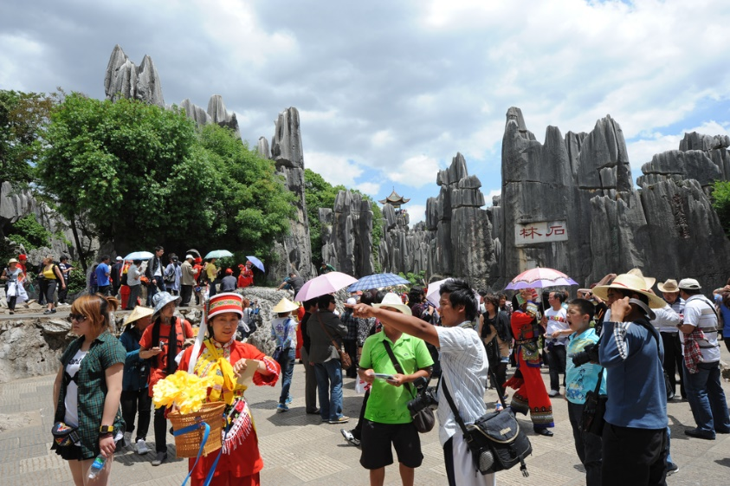
Use prepared aids and materials and equipment to support presentation
Human resources:
Observers
Performers and actors
Players, teams and troupes
Presenters and demonstrators
Guest speakers
Aides and assistants
Local/special interest groups
Notes:
Trainer continues to give examples of aids and materials commonly used:
Human resources – in the form of:
Sufficient observers – to monitor activities and intervene when safety is threatened
Performers and actors
Players, teams and troupes
Presenters and demonstrators
Guest speakers
Aides/assistants
Involvement of local/special interest organisations and groups,
Classroom Activity – Guest Speaker
Trainer arranges for Tour Guide to attend and:
Discuss preparation and use of aids and materials to support interpretive activities
Provide examples of same
Demonstrate use of same as part of presentation of an activity.

Slide 128

Use prepared aids and materials and equipment to support presentation
Equipment and technology:
May be required to present an activity
May be available at site/provided by the destination
May need to be loaded as part of standard resources required
Notes:
Trainer discusses equipment and technology stating:
It may be required to present and/or conduct an activity
These items may:
Be available at the activity site by prior arrangement/supplied as a matter of course by the destination
Need to be taken to the activity site/venue by the Tour Guide.
Classroom Activity – Internet Research
Trainer oversees research of and discussion on sites such as:
http://www.phonak-communications.com/en/products/tour-guiding/ - Phonak tour guiding
http://www.acoustiguide.com/group-guiding - Acoustiguide group guiding.

Slide 129

Use prepared aids and materials and equipment to support presentation
Equipment and technology may include:
PA systems and microphones
Megaphones
Overhead projectors and data projectors
Slides and transparencies
Sound and lighting technologies
Laser pointers
Personal electronic devices
Notes:
Trainer advises equipment and technology often includes:
PA systems and microphones
Megaphones
Overhead projectors
Data projectors
Slides and transparencies
Sound and lighting technologies
Laser pointers
Personal electronic devices.
Classroom Activity – demonstration and Practice
Trainer demonstrates use of a range of equipment and technology for presenting interpretive activities as identified on the slide and provides opportunity for students to practice same.

Slide 130

Encourage audience participation, where appropriate
Tour Guides should encourage participation by tour group members but this must be done with sensitivity because:
Some people simply do not want to participate in every activity
Some people are unable to participate in every activity
Notes:
Trainer states where appropriate the Tour Guide should encourage individuals in the tour group/audience to participate in the activity but this must be done with sensitivity and it is important to be sensitive in this regard because:
Some people simply do not want to participate in every activity – they may be:
Happy to observe and watch what others do
Seeking to simply experience the moment on their own
Shy and/or self-conscious
Confined by traditional thinking
Some people are unable to participate in every activity – due to:
Tiredness
Lack of physical capacity/ability
Health/medical reasons
Need to care for/look after other.

Slide 131
Encourage audience participation, where appropriate
Ways to encourage participation/engagement with activities:
Being personally enthusiastic about the activity
Verbally motivating people
Circulating throughout the group
(Continued)
Notes:
Trainer explains encouraging active engagement of tour group members with activities can be achieved by:
Being personally enthusiastic about the activity – with reference to:
Personal energy levels
Actions
Body language
Verbally motivating people – through actions such as:
Providing clear and detailed information and instructions
Giving tips about how to optimise the performance of the tour group members
Providing additional demonstration of what is required
Highlighting the benefits of the activity and the gains which can flow from engagement
Speaking from personal experience about feelings regarding involvement
Drawing comparisons with other activities and/or situations
Circulating throughout the group – and:
Demonstrating personal passion for the activity
Adding extra information or advice according to specific context
Offering comment based on identified need
Asking people about their progress and experience
Setting achievable/realistic targets/challenges for individuals or groups
Being understanding when people do not want to engage/participate
Sharing frustrations and disappointments.

Slide 132
Encourage audience participation, where appropriate
Tailoring provision of additional/ongoing information to the identified needs of the group
Using a prop kit
Using variety of approaches
(Continued)
Notes:
Trainer continues to present ways to encourage participation:
Tailoring provision of additional/ongoing information to the identified needs of the group – while the scripted commentary will/should have done this, it is also essential to do this with ‘issues arising’ throughout the activity such as:
In response to questions
When unexpected events and sights arise
Using a prop kit – to add action, excitement, interest and flavour
Always consider including props which can be given to, and used by, tour group participants as a way of involving and including them – see previous notes
Using variety of approaches – this means ‘mixing it up when communicating through the use of:
Humour
Statistics
Questions
Personal anecdotes and experiences
Highlighting unexpected occurrences – and including them in interactions with the group or individuals.

Slide 133
Encourage audience participation, where appropriate
Highlighting unexpected occurrences
Interacting with all tour group members on an ongoing basis
Improvising commentary
(Continued)
Notes:
Trainer continues to present ways to encourage participation:
Highlighting unexpected occurrences – and including them in interactions with the group or individuals
Interacting with all tour group members on an ongoing basis – through personal exchanges and shared experiences and feelings
Many complaints about a Tour Guide relate to their failure to mix with people, talk to/with them, and/or to demonstrate engagement with them
Improvising commentary – by incorporating topics of current interest to the group as identified through interaction with them during the activity and/or tour.

Slide 134
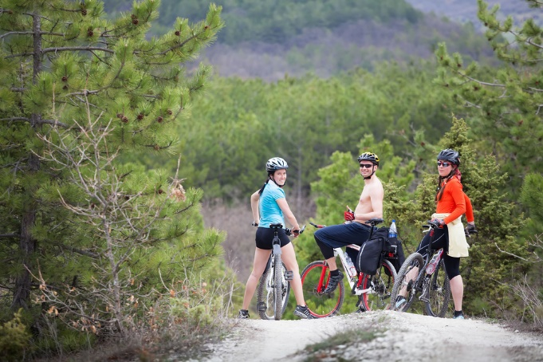
Encourage audience participation, where appropriate
Striving to deliver excellent service at all times regardless of the problems or situations which present themselves
Demonstrating interest in tour group members
Notes:
Trainer continues to present ways to encourage participation:
Striving to deliver excellent service at all times regardless of the problems or situations which present themselves – this involves:
Turning negative circumstances into positive demonstrations of good service, wherever possible
Asking people to do things, rather than telling them
Smiling
Treating tour group members as individuals and not as a ‘herd’
Responding to requests where possible – and explaining why not when requests cannot be met
Being polite and courteous
Keeping promises made about the tour and the activity
Providing relevant, accurate, timely and informative commentary and comments
Keeping tour group members informed about the need to change planned/schedules activities – explaining the reasons why and (where possible) substituting a suitable alternative
Demonstrating interest in tour group members – and their past, current and future experiences, such as:
Where they have been
Where they are going
What they will be doing tomorrow/next week.

Slide 135

Encourage audience participation, where appropriate
Tour Guides may need to generate confidence in abilities of tour group members to:
Optimise engagement with activities
Enable people to get the most from their experience
Demonstrate Tour Guide interest in individual tour group members and a willingness to help them
Reassure people about the safety of activities
Help customers believe they can do whatever is required
Notes:
Trainer discusses Tour Guide need to generate confidence in tour group members in relation to interpretive activities noting this may be required in order to:
Optimise engagement with activities
Enable people to get the most from their experience
Demonstrate Tour Guide interest in individual tour group members and a willingness to help them
Reassure people about the safety of activities
Help customers believe they can do whatever is required.

Slide 136

Encourage audience participation, where appropriate
Ways to generate tour group member confidence in their abilities include:
Talking about the activity
Demonstrating what to do
Providing personal/one-on-one assistance
Screening an instructional DVD
(Continued)
Notes:
Trainer observes confidence may be generated by:
Talking about the activity and giving examples of:
What is required
What can be expected
Demonstrating what to do
Providing personal/one-on-one assistance
Screening an instructional DVD.

Slide 137

Encourage audience participation, where appropriate
Initiating interaction on a graduated basis
Congratulating individuals on effort as well as achievement
Encouraging people to continue trying
Notes:
Trainer continues to provide ways to generate tour group member confidence in their ability:
Initiating interaction on a graduated basis – so the intensity of engagement increases as the skill/confidence of the individual grows
Congratulating individuals on effort as well as achievement
Encouraging people to continue trying.

Slide 138

Respond to questions
Tips for answering questions:
Thank the person for the question
Mention the person’s name when thanking them
Smile when responding – if appropriate
(Continued)
Notes:
Trainer presents tips for answering questions asked as part of an activity include:
Thank the person for the question – this encourages others to ask questions as it shows questions are actually welcomed
Mention the person’s name when thanking them – many participants wear name tags which can be used to identify who they are
This personalises the answer and people love to hear the sound of their own name
Smile when responding – if appropriate – this is another way of showing providing answers to questions is not an imposition.

Slide 139

Respond to questions
Use polite and respectful language
Provide a direct answer to the question which was asked
Ensure personal opinion in an answer is specifically identified as such
(Continued)
Notes:
Trainer continues to present tips for answering questions asked as part of an activity:
Use polite and respectful language – when replying, including the use of humour, where appropriate
Provide a direct answer to the question which was asked – this means:
Giving a full, detailed, comprehensive and honest answer as relevant to the question
Not avoiding the question or re-directing or re-framing it
Being prepared to say “I’m sorry but I don’t know the answer to that question.” See below for more on this
Never fabricating answers
Ensure personal opinion in an answer is specifically identified as such – and not offered as fact
There is room when replying to some questions for the Tour Guide to offer personal opinions as part of certain answers (for example, questions asked regarding where to eat, the name of a good hotel, recommendations for other tours to take, identification of places to avoid) but it is important to make sure the customers know which part of the response it is.

Slide 140

Respond to questions
Present the answers to the most appropriate ‘target’
Respond promptly
Check the response has answered the question to satisfaction of the person who asked it
Notes:
Trainer continues to present tips for answering questions asked as part of an activity:
Present the answers to the most appropriate ‘target’ – in some cases:
The answer is best given just to the person who asked the question
It is better to include the rest of the group in the response which is provided
Respond promptly – taking care:
Never to rush the response
Not to appear curt
To not give the impression there are better things to be done
Check the response has answered the question to satisfaction of the person who asked it – this can involve:
Encouraging another question
Enquiring if clarification is needed
Asking if illustration of a point is required.
Classroom Activity – Demonstration and Practice
Trainer demonstrates how respond to questions asked by tour group members in relation to an interpretive activity and provides an opportunity for students to do the same.

Slide 141

Respond to questions
Where the answer to a question is not known:
Apologise for not knowing
Maintain positive relations with the person/group
Give information on an associated topic
(Continued)
Notes:
Trainer explains strategy for responding to questions where the Tour Guide does not know the answer:
Apologise for not knowing – this is a standard ‘customer service’ response and needs to be done
The apology needs to be genuine and accompanied by appropriate supporting body language/facial expressions
Maintain positive relations with the person/group – it is important:
Not to show annoyance at not knowing the answer
Not to be personally embarrassed about the lack of knowledge
Not to give the person who asked the question the impression they should ask no more questions
Give information on an associated topic – which:
May give some generally broad detail in relation to the actual question asked
At least shows a willingness to respond even though the real answer is not known.

Slide 142

Respond to questions
Refer the question to the rest of the group
Refer customers to sources that may provide relevant information at the conclusion of the activity or tour
Make arrangements to research the question and pass answer on
Notes:
Trainer continues to explain strategy for responding to questions where the Tour Guide does not know the answer:
Refer the question to the rest of the group – to see if anyone else participating in the activity has an answer to the question
Refer customers to sources that may provide the relevant information at the conclusion of the activity or tour – this may be:
Brochures, posters, handouts which are available at the point of disembarkation
A website
A Visitor Information Centre
A business, organisation or government agency/authority
Make arrangements to research the question – at the conclusion of the activity or tour and:
Pass on the answer face-to-face at the point of disembarkation, if the person is willing to wait a few minutes
Send a reply via email to the person if they are able to provide an address
Give an SMS reply if they provide a number.
Classroom Activity – Demonstration and Practice
Trainer demonstrates how respond to questions asked by tour group members where the Tour Guide does not know the answer and provides an opportunity for students to do the same.

Slide 143

Respect environmental, cultural and social sensitivities
Can be a need to follow strict protocols/Codes when:
About to enter a local/host community or area
Tour Operator belongs to a body/association requiring Code to be communicated and followed while ‘on site’
Such agreements have been negotiated with local community
Notes:
Trainer reminds in some circumstances there can be a need to follow strict protocols make tour group members aware of requirements which apply to an upcoming activity and these protocols (often referred to as a Code of Conduct/Practice) often have to be observed when:
About to enter a local/host community or area
The Tour Operator belongs to a body/association who requires the Code to be communicated to customers and followed while ‘on site’
Such agreements have been negotiated with the people from an area/the lands to be visited.

Slide 144

Respect environmental, cultural and social sensitivities
Notification in this regard may occur:
In hard copy form/handouts to tour group members
Verbal communication on the tour vehicle or at the activity site
Notes:
Trainer indicates notification about the requirements of the Code will commonly take the following forms:
Inclusion of a hard copy of the Code in materials handed out to tour group members either:
When they buy/receive their tickets
As part of a pre-tour briefing
Verbal communication to customers – which may occur:
On the tour vehicle as the destination for the activity approaches
As part of a formal pre-activity briefing.

Slide 145

Respect environmental, cultural and social sensitivities
General consideration in Codes:
Determination of ‘unacceptable’ behaviour
Requirement for all tour groups to be briefed
Need for Tour Guides to intervene where necessary
Need for adherence to all agreed/negotiated arrangements
Consequences for non-compliance
Notes:
Trainer instructs general considerations relating to Codes include:
Determination of ‘unacceptable’ behaviour of tour groups and individual participants – as relevant to each site/community
Requirement for all tour groups to be briefed by Tour Guides before entering the community – highlighting what is deemed to be ‘acceptable behaviour’ in accordance with a prepared script developed in consultation with the local community
Need for Tour Guides to intervene where necessary – and bring unacceptable behaviour by tour group members back in-line with what is required
Need for adherence to all agreed/negotiated arrangements – at all times by all groups
Consequences which apply for non-compliance.

Slide 146

Respect environmental, cultural and social sensitivities
Topics covered by Codes may relate to:
Parking only in designated areas
Staying on designated walking tracks
Prohibiting taking of photographs
Banning use of limited/scarce local resources
Identifying and banning carriage of nominated items/products onto community lands/property
Cleaning up after using facilities
Notes:
Trainer gives specific examples of topics covered in Codes:
Parking only in designated areas
Staying on designated walking tracks and agreed pedestrian routes
Prohibiting taking of photographs – of certain areas or of people
Banning use of limited/scarce local resources – such as water
Identifying and banning carriage of nominated items/products onto community lands/property (such as fast food, newspapers, bottles)
Cleaning up after using facilities – or a ban on using facilities.
Classroom Activity – Handouts
Trainer distributes and discusses examples of Codes of Practice/Conduct required of tour groups in certain areas/communities.

Slide 147

Respect environmental, cultural and social sensitivities
Environmental issues and sensitivities may be related to:
Minimising impact on the environment
Rehabilitation
Land, flora, fauna, natural resources, pollution
Notes:
Trainer advises Environmental issues (and hence sensitivities) may be related to:
Minimising impact on the environment
Redressing previous adverse impact on the environment - rehabilitation.
For the purposes of this section ‘the environment’ must be seen in its broadest context to embrace the widest range of topics relating to:
Land
Flora
Fauna
Natural resources – conservation of water and air
Pollution – including soil, water, air and noise pollution.

Slide 148
Respect environmental, cultural and social sensitivities
Ways to demonstrate respect for the environment:
Not using local resources
Limiting/restricting/rationing use of local resources
Removing all rubbish created by the group/activity
Staying on designated tracks, paths, areas
Not picking the flowers
(Continued)
Notes:
Trainer indicates respect for environmental sensitivities may be demonstrated through actions such as:
Not using local resources
Limiting/restricting/rationing use of local resources
Removing all rubbish created by the group/activity
Staying on designated tracks, paths, areas
Not picking the flowers.

Slide 149
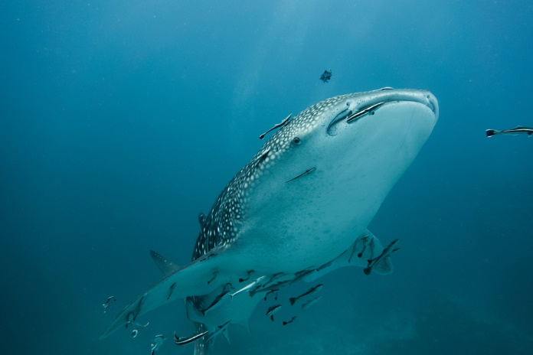
Respect environmental, cultural and social sensitivities
Staying a set distance from wildlife
Using only specifically identified and agreed areas for activities
Limiting number of visits to the area
Restricting number of tour group members and duration of activities
(Continued)
Notes:
Trainer continues presenting ways to demonstrate respect for environmental issues:
Staying a set distance from wildlife
Using only specifically identified and agreed areas for activities
Limiting number of visits to the area
Restricting number of tour group members and duration of activities.

Slide 150

Respect environmental, cultural and social sensitivities
Banning carriage of nominated items (known to cause damage/pollution) into the area
Confining interpretive activities only to approved actions which have been agreed to by local/host communities
Helping local communities in whatever way they require in order to rehabilitate and/or conserve their environment
Notes:
Trainer continues presenting ways to demonstrate respect for environmental issues:
Banning carriage of nominated items (known to cause damage/pollution) into the area
Confining interpretive activities only to approved actions which have been agreed to by local/host communities
Helping local communities in whatever way they require in order to rehabilitate and/or conserve their environment – as agreed through consultation and negotiation.

Slide 151

Respect environmental, cultural and social sensitivities
Cultural issues and sensitivities may relate to:
Religion
Race
Language and symbols
Norms, beliefs and assumptions
Notes:
Trainer advises for the purposes of this section, cultural issues (and hence sensitivities) may be related to:
Religion
Race
Language and symbols
Norms, beliefs and assumptions.

Slide 152

Respect environmental, cultural and social sensitivities
Ways to demonstrate respect for cultural issues:
Participating in ‘cultural awareness’ training
Learning about non-verbal communications relevant to the culture/s of people who are regular tour participants
Speaking in languages native to tour group members
Providing written material in different languages
Not pre-judging/stereo-typing people
(Continued)
Notes:
Trainer indicates respect for cultural sensitivities may be demonstrated through actions such as:
Attending/participating in ‘cultural awareness’ training as part of standard Tour Guide training
Learning about the meaning of a range of non-verbal communications relevant to the culture/s of people who are regular tour participants – to avoid giving unintentional offence
Speaking in language that can be understood by tour group members
Providing written material in different languages
Not pre-judging/stereo-typing people based on their obvious cultural indicators.

Slide 153

Respect environmental, cultural and social sensitivities
Avoiding race/culture-specific jokes
Checking symbols, signs, examples and activities used are not offensive
Refraining from culturally-based comments
Demonstrating inclusivity
Not joining in with culturally inappropriate behavior or language
(Continued)
Notes:
Trainer continues presenting ways to demonstrate respect for cultural issues:
Avoiding comments and jokes which are related to specific cultures
Checking to ensure symbols, examples and activities used as part of an activity are culturally appropriate
Refraining from comments which can be interpreted as being culturally-based
Embracing/including all tour group members in conversation, provision of assistance, interaction and other activities
Not joining in when/if customers engage in culturally inappropriate behaviour or language.

Slide 154

Respect environmental, cultural and social sensitivities
Intervening when a need to do so arises
Acknowledging differences
Avoiding discriminatory language
Being patient and understanding with people from different backgrounds
Notes:
Trainer continues presenting ways to demonstrate respect for cultural issues:
Intervening when a tour group member says or does something which is culturally insensitive
Acknowledging differences and embracing diversity
Offering all tour group members the same opportunity to engage with activities
Avoiding any form of negative discriminatory behaviour or language
Being patient and understanding.

Slide 155

Respect environmental, cultural and social sensitivities
Social issues and sensitivities may relate to:
Personal values and norms
Family units
Individual circumstances
Age
Gender and sexual identity
Disability
Notes:
Trainer advises for the purposes of this section, social issues (and hence sensitivities) may be related to:
Personal values and norms
Family units
Individual circumstances
Age
Gender and sexual identity
Disability.

Slide 156

Respect environmental, cultural and social sensitivities
Ways to demonstrate respect for social issues:
Acknowledging personal rights and freedoms
Not judging people by their actions
Supporting and helping individuals who are experiencing personal difficulties and hardship
Using inclusive language
(Continued)
Notes:
Trainer indicates respect for social sensitivities may be demonstrated through actions such as:
Acknowledging personal rights and freedoms
Not judging people by their actions
Supporting and helping individuals who are experiencing personal difficulties and hardship when on-tour and/or as they participate in an activity
Using inclusive language.

Slide 157

Respect environmental, cultural and social sensitivities
Not making inflammatory remarks/comments when an individual’s social issue/s cause delay or disruption to other tour group members
Appreciating individual differences
Intervening when a tour group member says or does something which is insensitive
(Continued)
Notes:
Trainer continues presenting ways to demonstrate respect for social issues:
Not making inflammatory remarks/comments when an individual’s social issue/s cause delay or disruption to other tour group members
Appreciating individual differences
Intervening when a tour group member says or does something which is insensitive to a person’s social circumstance/s.

Slide 158

Respect environmental, cultural and social sensitivities
Not making personal comment about a person’s social circumstances, choices or arrangements
Treating everyone equally but providing extra assistance to those who are challenged or disenfranchised by virtue of social factors
Catering for disabilities
Showing understanding/empathy for people’s thoughts and feelings
Notes:
Trainer continues presenting ways to demonstrate respect for social issues:
Refraining from making personal comment about a person’s social circumstances, choices or arrangements
Treating everyone equally but being ready to provide extra attention/assistance to those who are challenged or disenfranchised by virtue of social factors
Catering for disabilities as required/notified in advance
Showing understanding/empathy for people’s thoughts and feelings.

Slide 159
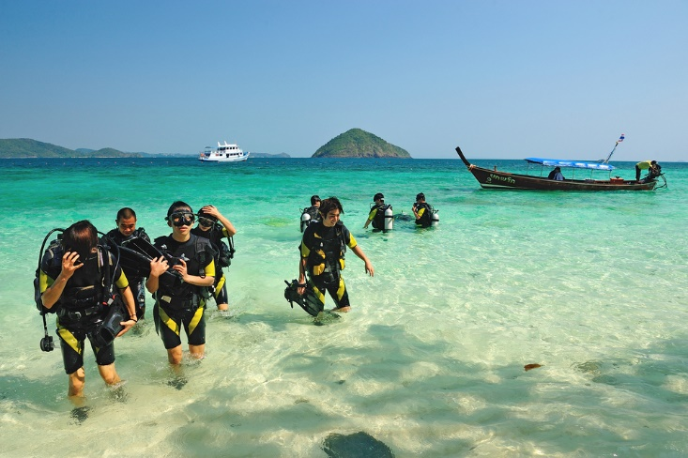
Adjust presentation to suit emerging requirements
Reasons to monitor and adjust presentations:
Optimise customer enjoyment and engagement
Accommodate and respond to issues arising
Keep the activity on schedule
Cater for individual needs
Demonstrate customer-focus and service
Notes:
Trainer highlights there is an ongoing need to monitor the activity and adjust it to suit emerging requirements in order to:
Optimise customer enjoyment and engagement
Accommodate and respond to general issues arising for the group
Keep the activity on schedule and the tour running according to the itinerary
Cater for individual needs, wants and preferences as they are identified
Demonstrate customer-focus and a genuine service ethic.

Slide 160

Adjust presentation to suit emerging requirements
All activities are unique due to the dynamic mix of:
Tour group members
Activity type
Location
Conditions
Notes:
Trainer explains each tour/activity is unique mentioning:
The actions required to effectively adjust presentations for each interpretive activity will vary with each tour and activity
It is important to remember every activity is a unique event even where the title/name of the activity is the same. No two interpretive activities are really ever the same because of the dynamic mix of:
Tour group members – by age, gender, background, experience, expectations and number
Activity type – and the whether or not the activity is essentially:
Passive or active
Observational or participatory
Group-based or individual
Location – in terms of the changes which can occur as a result of crowds, weather, seasons and equipment/resources factors.

Slide 161

Adjust presentation to suit emerging requirements
Decision to make adjustments should be based on:
Feedback from the group
Local factors
Personal experience
Common sense
Knowledge gained about the tour group members
Knowledge held about the tour/activity to-date and the remaining inclusions and activities on the tour
Notes:
Trainer advises adjustments to presentation will need to be made on-the-spot by the Tour Guide based on:
Feedback from the group
Local factors
Personal experience
Common sense
Knowledge gained about the tour group members
Knowledge held about the tour/activity to-date and the remaining inclusions and activities on the tour.

Slide 162
Adjust presentation to suit emerging requirements
Options for adjusting presentation:
Changing the basic tenor of an activity
Altering the pacing of the presentation
Changing the scope of the activity itself
Adjusting the duration of the activity
(Continued)
Notes:
Trainer suggests options for adjusting presentation may require:
Changing the basic tenor of an activity – which may mean:
Switching from an active to a passive orientation
Allowing the tour group to determine their approach to the activity rather than insisting the plans for the activity are followed
Altering the pacing of the presentation – by (for example)
Speeding up or slowing down commentary
Adding more information or omitting ‘nice to know’ information and presenting only the ‘need to know’ detail
Changing the scope of the activity itself – by:
Adding new or different elements
Reducing objectives and/or dimensions of the activity
Adjusting the duration of the activity – which may take the form of:
Making the activity longer or shorter
Breaking the overall activity up into smaller, discreet sections
Introducing breaks/rests periods into the activity.

Slide 163
Adjust presentation to suit emerging requirements
Addressing the degree of engagement/participation of the tour group with the activity
Taking action in relation to the administration of the activity
Moving the location of the activity
(Continued)
Notes:
Trainer continues to suggest options for adjusting presentation:
Addressing the degree of engagement/participation of the tour group with the activity – which will commonly require either:
The tour group members to do more or less
The tour group members to do something different – such as something more active or less active/challenging/hands-on
The Tour Guide and/or tour staff members to do more or less
Taking action in relation to the administration of the activity – which may require changes in relation to:
Monitoring of the group
Supervision of the activity
Provision of further advice
Feedback given
Moving the location of the activity – to:
A better area given the nature of issues arising
A safer site.

Slide 164

Adjust presentation to suit emerging requirements
Responding to initial assessment of participant physical ability
Responding to changing environmental and other factors
Abandoning the planned activity and initiating a substitute/alternative activity
(Continued)
Notes:
Trainer continues to suggest options for adjusting presentation:
Responding to initial assessment of participant physical ability – and conducting a subsequent re-assessment based on their demonstrated capacity
Responding to changing environmental and other factors – including those related to:
Safety
Weather
Environment
Abandoning the planned activity and initiating a substitute/alternative activity – where the original interpretive activity appears to be unacceptable and inappropriate to the group.

Slide 165

Adjust presentation to suit emerging requirements
Allocating more and/or different resources, gear and equipment
Being prepared to amend the itinerary for the tour in consultation with the group
Altering the level of communication and interaction with individuals and/or groups
Notes:
Trainer continues to suggest options for adjusting presentation:
Allocating more and/or different resources, gear and equipment – to address resourcing issues which have occurred
Being prepared to amend the itinerary for the tour in consultation with the group – where the presentation of this activity appears to warrant such a response
Altering the level of communication and interaction with individuals and/or groups – to:
Make people feel more included
Address signs of distress, fatigue or other negative signals
Enhance the connection between Tour Guide and the individual.
Classroom Activity – Excursion
Trainer arranges for class to participate in a (different to earlier) tour featuring (different) interpretive activities so they can:
Gain first-hand experience of tours and activities
Observe occurrences and work of tour staff
Talk with tour staff
Obtain handout materials
Observe tour group members and their reactions to activities and interactions with tour staff.

Slide 166

Liaise with colleagues throughout the activity
Colleagues may include people/personnel from:
Local/host communities
Tour Operator
Third party providers/suppliers
(Continued)
Notes:
Trainer identifies colleagues as possibly including:
Host communities – including:
Acknowledged community leaders
Designated elders
Nominated spokespeople or representatives
Vehicles operated by third party carriers in these communities
Tour operator employees who are also part of the tour group – such as:
Tour managers
Drivers of coaches and other vehicles owner and operated by the Tour Operator
Employees responsible for loading vehicles and conducting pre-departure checks
Security and/or safety staff
Aides and assistants
Cooks
Third party providers, joint venture partner and agencies – in terms of:
Drivers they use/provide
People provided to ‘meet and greet’ tour group members and to provide other services at and within activities
Caterers
Animal handlers .
Classroom Activity – Guest Speaker/s
Trainer arranges for selection of people from those mentioned on the slide to attend and:
Discuss their roles in interpretive activities
Illustrate the need for communication throughout interpretive activities
Explain how the liaison occurs.

Slide 167

Liaise with colleagues throughout the activity
Local guides
‘Contacts’
Land owners/managers
Representatives from government authorities/agencies
Notes:
Trainer continues to identify colleagues as possibly including:
Local and independent guides – who may be have a role to play in:
Leading part of the tour
Conducting an activity
Designated/arranged persons (‘Contacts’) at destinations, suppliers and venues – including:
Hotels and restaurants
Attractions and sites
Retail shops
Land owners and land managers – for areas which:
May be protected by legislation or regulation
May be subject to special listing and access requirements
Require payment of access/user fees on arrival
Representatives of statutory authorities – who may need to be advised of:
Plans and intentions – for tours and activities
Projected usage of areas/sites
Numbers of visitors
Other detail as applicable to the individual agency/authority.
Classroom Activity – Guest Speaker/s
Trainer arranges for selection of people from those mentioned on the slide to attend and:
Discuss their roles in interpretive activities
Illustrate the need for communication throughout interpretive activities
Explain how the liaison occurs.

Slide 168

Liaise with colleagues throughout the activity
Examples of liaison activities:
Responding to requests from people/colleagues for assistance
Asking for assistance
Communicating with individuals and properties
(Continued)
Notes:
Trainer illustrates the nature of liaison activities with others:
Responding to requests from people/colleagues for assistance – these can come from destinations, carriers and suppliers in cases where (for example):
They notify they are unable to provide normal services as previously arranged/expected
They advise scheduled activities cannot be delivered at planned times
The expected/organised meals and/or some other service cannot be supplied as arranged
Asking them for assistance – as dictated by a wide number of potential reasons such as:
Seeking to accommodate special needs customers who have been identified as the activity begins/progresses
Requesting changes to normal arrangements – to accommodate issues arising as the activity proceeds
Responding to specific requests made by tour group members while participating in the activity
Communicating with individuals and properties – in order to:
Make operational decisions
Alter planned arrangements
Advise of changes and issues impacting the activity, the tour and the itinerary
Keep people appraised of tour progress and where the tour ‘currently’ is and its expected arrival at other locations and activities.

Slide 169
Liaise with colleagues throughout the activity
Providing support for the work of others
Anticipating requests from colleagues
Communicating with venues, sites, destinations and providers
Making payment for services and products
Notes:
Trainer continues to illustrate the nature of liaison activities with others:
Providing support for the work of others – such as:
Supplying information and facts as required by others in relation to the tour and operational details of individual activities
Passing on feedback received from tour group members about the activity and the tour
Assisting others complete their work as it relates to the activity
Integrating other/new requested work-related activities into standard interpretive activity protocols
Anticipating requests from colleagues – and:
Responding positively
Responding proactively
Striving to achieve a mutually beneficial outcome
Communicating with venues, sites, destinations and providers – and:
Confirming forward bookings
Advising sites and operators of expected arrival time, group numbers, special requests and timing constraints that may apply
Making arrangements
Negotiating changes to standard arrangements
Making payment for services and products rendered according to previously agreed arrangements, or as required – to:
Suppliers/providers
Communities
Carriers.

Slide 170
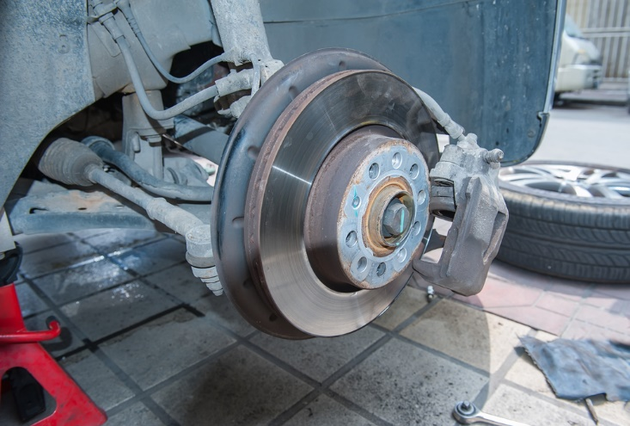
Deal with unexpected events
Causes of unexpected events may be:
Systems failure/s
Tour vehicle problems
Accident, injury or death of tour member
(Continued)
Notes:
Trainer states the nature of unexpected events and emergencies can vary with different tours and various activity types but may include:
Systems failure – including significant technical and equipment failure
Incidents relating to tour vehicle – such as:
Vehicle breakdown
Vehicle accidents
Situations involving tour group members – which may result in:
Injury
Accident
Death.

Slide 171
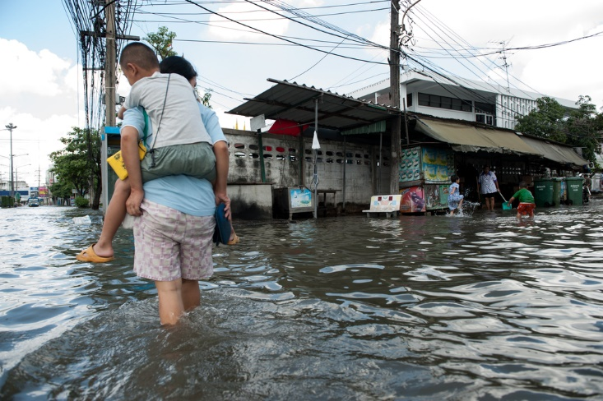
Deal with unexpected events
Inappropriate behaviour
Adverse weather
Unpredictable animal behaviour
(Continued)
Notes:
Trainer continues to give factors which may cause unexpected events:
Inappropriate customer behaviour – which is:
Impacting the enjoyment of the tour by other tour group members
Contravening expected codes of conduct
Adverse weather conditions – including:
Unsafe or inappropriate local conditions
The impact locally (potentially and/or actually) of adverse weather conditions in a near-by or associated area – such as localised flooding caused by heavy rain in a near-by catchment area
Unpredictable animal behaviour – such as:
Presence of wild animals
Creatures which are normally placid but are proving to be uncontrollable.

Slide 172
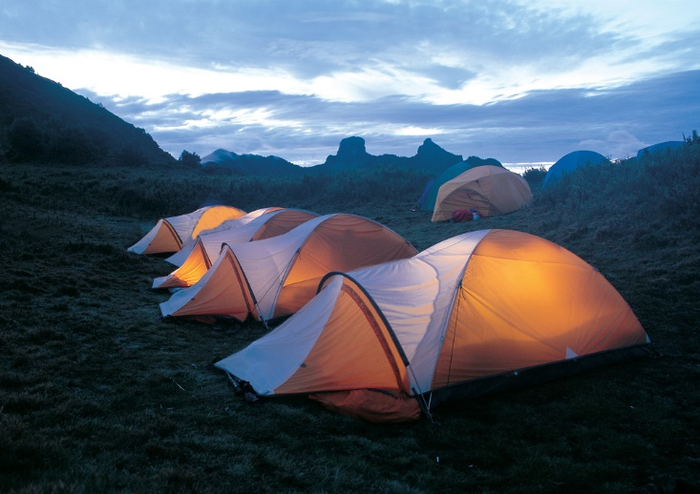
Deal with unexpected events
Problems with sites
Unanticipated/problematic composition of tour group
Delays caused by tour group members
Notes:
Trainer continues to give factors which may cause unexpected events:
Problems with sites, venues and/or destinations – such as:
Impassable roads
Unexpected closures of sites
Unannounced restricted access to traditional areas
Permits and permissions for areas which were previously granted being revoked
Unanticipated composition of tour group – that is, the tour group:
Is too large or small
Comprises people with unexpected demographic characteristics
Delays caused by tour group members – such as:
Delays in terms of tour group members returning to a muster point
Delays caused by participants re-boarding the tour vehicle.

Slide 173

Deal with unexpected events
It should be standard practice to:
Try to predict ‘unexpected events’ and emergencies
Plan for what is identified
Create:
Operational plans
Emergency Management plans
Contingency plans
Notes:
Trainer introduced contingency planning/plans stating:
Unexpected events and emergencies should be planned for, as far as practicable, so that contingency plans or emergency plans can be put into effect when required
It is SOP for tours to have three types/levels of plans created for them:
Operational plans – these are the standard plans to be implemented/followed if everything goes according to plan
Emergency plans – to be followed if there is an accident or another prescribed emergency impacts the tour/activity
Contingency plans – see following slides.
Classroom Activity – Handouts
Trainer distributes and discusses examples of Operational and Emergency (Management) plans.

Slide 174

Deal with unexpected events
Pre-requisites for effective plans:
Adequate resources
Trialling and testing
Review and revision
Must be communicated
Practice/drills must underpin implementation
Post-activity review/up-dates
Notes:
Trainer explains for plans to be effective several pre-requisites exist:
They need to be properly and adequately resourced
They need to trialled and tested
The trials/tests needs to be reviewed and the plans revised, as/if necessary
They need to be communicated to staff
Demonstrations, practice and/or drills must underpin actual implementation
They need to be reviewed and updated as tours and requirements/relevant issues alter.

Slide 175

Deal with unexpected events
Provision of plans to tour staff:
Plans may be provided by the Tour Operator in an ‘Operations Package/Folder
or
Plans may be available via electronic devices
Notes:
Trainer indicates all plans are prepared in advance/before the tour/excursion departs and provided for tour staff in an Operations Package/Folder that contains copies of all relevant plans for individual tours/excursions.
All plans are usually also available in soft copy form via various electronic options such as Iphones, pads or tablets.
Classroom Activity – Handout
Trainer distributes and discusses sample Operations Package/Folder.

Slide 176
Deal with unexpected events
Contingency plans:
Are Plan B
They detail what to do if normal events/activities cannot be implemented or followed
They deal with issues that are not emergencies but have the potential to disrupt the tour
Notes:
Trainer discusses
Contingency plans
Contingency plans are:
Plans prepared for tour staff to follow in case certain predictable, foreseeable or likely events actually materialise
They are Plan B – they detail what will be done when Plan A (what should normally occur as planned/as usual) cannot happen/take place
These events are not ‘emergencies’ (that is, they do not put life or property in danger) but they have the potential to cause disruption to the tour/excursion and cause disappointment to customers.

Slide 177
Deal with unexpected events
Contingency plans are prepared to:
Ensure smooth operation even if there are problems
Control costs, timing and activities
Optimise chance of meeting expectations
Provide direction to staff about what to do
Comply with obligations
Notes:
Trainer explains need for contingency plans – to:
Ensure tours/activities operate smoothly event when there are difficulties/problems
Control costs, timing and activities where there is a need to deviate from standard operational plans
Optimise potential of tours/activities to meet customer expectations even where unexpected situation occur
Give direction to Tour staff when things go wrong or do not go as planned/expected
Comply with legislation and legal obligations regarding delivering a tour that complies with advertisements.

Slide 178
Deal with unexpected events
Contents of Contingency plans for interpretive activities:
Name of activity
Name of tour
Relevant dates
Trigger points for implementation
(Continued)
Notes:
Trainer states individual Tour Operators will determine the specific contents of their own contingency plans for interpretive activities but generically speaking they will contain:
Name/title of the activity – so there is clarity about the focus of the plan/the particular interpretive activity to which the plan applies
Name of the Tour to which the plan applies – this is the name of any/every tour that includes the activity
Relevant dates – including:
Dates plan was developed and approved for use
Review date for plan
Trigger points for implementation – these points will vary between activities but each listed trigger point will:
Describe general context for activation of the plan
Illustrate with reference to specific examples of scenarios, situations and circumstances
Indicate when and why:
Alternate activities should be substituted
Planned/scheduled activities need to be abandoned and no replacement activity provided in its place
The Terms and Conditions which tour participants agree to when they buy a tour/ticket usually contains a statement allowing Tour Operators to substitute activities, cancel activities or in other ways amend/alter the advertised itinerary.
Classroom Activity – Handout
Trainer distributes and discusses example of tour ‘Terms and Conditions’ highlighting statements regarding rights of Operator to substitute/cancel activities.

Slide 179
Deal with unexpected events
Lists/sets of action to take
Required notifications
Prompts for other considerations
Notes:
Trainer continues presenting contents of Contingency plans for interpretive activities:
Action to be taken – which will cover:
Alterations to announcements, demonstrations/briefings and advice to participants to be made
Changes which may be required to the activity itself – in terms of :
Scope; Duration; Engagement/participation; Resource allocations; Monitoring and supervision of the activity
Location of activity
Presentation of detailed operational plans for alternate/substitute interpretive activities
Required notifications – these may relate to:
Notifying management/Head Office
Advising other tours/Tour Guides
Communicating with local communities
Liaising with third party providers
Prompts/lists of other factors which may potentially need to be considered as a consequence – these may include:
Adjustments to other interpretive activities
Variations to the itinerary
Acquisition of extra supplies/resources
Need to complete specified internal report at the end of the tour to explain/address the issue.
Classroom Activity – Handout
Trainer distributes and discusses example of Contingency plans for interpretive activities.

Slide 180
Deal with unexpected events
General requirements for dealing with unexpected events:
Implementing pre-prepared plans
Notifying authorities/emergency services
Maintaining communication with the tour group
(Continued)
Notes:
Trainer discusses dealing with events and emergencies stating in practice the detail of handling events and emergencies will be contained in the plans, but generically the requirements may include:
Implementing contingency and/or emergency plans – as developed for each individual tour or activity
Notifying authorities and/or emergency services – by phone or radio to obtain assistance
The Operations Package/Folder for the tour will contain these plans and/or they may be available electronically
Maintaining communication with tour group members – to:
Advise them of action they need to take to remain safe
Reassure them and keep them calm
Notify them of action to be taken by the tour in response to the unexpected event.

Slide 181
Deal with unexpected events
Prioritising action to be taken
Taking charge/control
Being proactive
(Continued)
Notes:
Trainer continues giving generic requirements for handling events and emergencies:
Prioritising action to be taken – this ALWAYS means optimising the safety of customers and placing the safety of people above the protection/security of property and assets
Taking charge of the situation – by:
Assuming authority
Taking charge
Issuing directives to those on-tour/in the tour group
Being proactive – in terms of:
Responding in an appropriate and timely manner
Taking action to minimise the adverse impact of the unexpected event on the conduct, and customer enjoyment of, the tour.

Slide 182
Deal with unexpected events
Apologising
Adhering to Tour Operator policies and procedures relevant to the situation
Notes:
Trainer continues giving generic requirements for handling events and emergencies:
Apologising for the event – this is standard practice even where the cause of the situation is not the fault of:
The tour
The Tour Guide
The Tour Operator
Adhering to host enterprise policies and procedures – with regard to:
Never admitting liability on behalf of the Tour Operator in relation to any event or incident
Not promising any form of recompense to those who have bought tickets/are on the tour
Referring customers to management, head office or to duty supervisor – on arrival of the tour back at the departure point, where applicable
Re-stating relevant statements in the Terms and Conditions of the tour – in relation to issues such as:
‘The Tour Operator reserves the right to substitute destinations, attractions, activities and inclusions as required’
‘Where there is a need to alter the advertised itinerary the Tour Operator will make every effort to replace the amended inclusion with an event/activity of similar type and value-for-money’.

Slide 183
Complete the activity
Every activity needs a proper ‘end’ because:
The end of the activity is as important as the start
The end of the activity is often the last thing the participant remembers
Participants pay for the entire experience
(Continued)
Notes:
Trainer states there is a need for a proper end to an activity because:
The end of the activity is as important as the start of the activity
The end of the activity is often the last thing the participant remembers – especially if it is not a positive conclusion
Participants pay for the entire experience – not just the beginning and the ‘middle.’

Slide 184
Complete the activity
It shows professionalism and demonstrates planning and organisation
It allows people to ‘finish up’
The activity needs to finish ‘on time’
Notes:
Trainer continues giving reasons every activity needs a proper end:
It shows professionalism and demonstrates planning and organisation
It allows people to ‘finish up’ – whatever that might mean for them
The activity needs to finish ‘on time’ – so that:
The itinerary can be maintained
Other activities booked for the same site/venue can take place.

Slide 185

Complete the activity
Generic practice for completing an activity will focus on:
Need to plan the end
Need to prepare for the end
Need to communicate with others
Notes:
Trainer identifies generic practice to deliver an effective and successful completion of an activity will focus on:
Need to plan the closure/completion
Need to prepare for the end of the activity
Need to communicate – with:
Staff who are assisting
Stakeholders
Tour group members/participants.

Slide 186

Complete the activity
SOPs for completing/closing an activity:
Remaining positive and up-beat
Communicating with other staff
Forewarning tour group members
(Continued)
Notes:
Trainer presents standard protocols for ending an activity:
Remaining positive and ‘up beat’ – and not allowing personal energy/enthusiasm drop off towards the end of the activity
Communicating with other tour staff and those working as part of the activity – in relation to:
Advising the activity will conclude in X minutes
Seeking confirmation from them it is appropriate to complete/finish up the activity
They should commence ‘close down’ actions as relevant to the individual activity
Forewarning customers in relation to the closure/end of the activity – which may be accomplished through:
Making a public announcement – using as appropriate:
PA system
Megaphone
Loud voice
Speaking to tour group members – quietly and individually or in small groups
Ringing a bell or some other visual or audible warning.
Classroom Activity – Demonstration and Practice
Trainer demonstrates practices for completing an interpretive activity as identified on the slide and provides opportunity for students to do the same.

Slide 187

Complete the activity
Providing a staged closure/finish
Initiating closing activities
Sharing feelings/thoughts of tour group members
Notes:
Trainer continues to present standard protocols for ending an activity:
Providing a staged-completion – that is, for example:
Stage 1: Advise of completion in 15 minutes
Stage 2: Advise of completion in 10 minutes
Stage 3: Advise of completion in 5 minutes
Stage 4: Advise activity is complete
Initiating closing activities – which will depend on the nature of the activity but may include:
Dimming lights
Turning down sound/volume
Turning off equipment
Collecting items
Closing entry points
Sharing feelings of the group/individuals – such as:
Amazement time has already passed and it is time to finish
Disappointment at having to leave
Enjoyment of the experience they have gained.

Slide 188

Complete the activity
Post-completion activities may be required – such as:
Counting participants
Retrieving items
Preparing for next group/activity
(Continued)
Notes:
Trainer advises after activities have been completed there can be a need to:
Count participant numbers/tour group members – to make sure no-one is missing/lost
Retrieve equipment and items that were distributed to customers – at the start of the activity and/or throughout it
Prepare equipment and items ready for the next activity/group – which may include:
Inspection
Maintenance
Cleaning.

Slide 189

Complete the activity
Removing damaged/unsafe equipment
Completing necessary paperwork
De-briefing with the group
Advising group of next/future arrangements
Notes:
Trainer continues to identify possible post-completion activities:
Remove damaged or malfunctioning equipment from service – and:
Tag as ‘Out of Service’
Arrange for replacements
Complete necessary paperwork – which may relate to:
Timing/direction of activity
Group/participant numbers
Staffing
Resources used
De-brief the group – to:
Share experiences
Identify lessons learned by the customers as a result of their engagement with the activity
Gather feedback about the activity
Advise group of future arrangements – which may address:
Timing, location and nature of next interpretive activity
Return travel
Changes to the itinerary
Meals.

Slide 190
Summary – Element 3
When conducting the interpretive activity:
Assemble the group
Check readiness and safety issues
Recap basic requirements
Encourage questions
(Continued)
Notes:
Trainer provides a recap of the Element asking questions to check trainee understanding and responding to questions from trainees, as required.

Slide 191
Summary – Element 3
Provide scripted and unscripted commentary
Follow the plan for the activity
Interact with customers using appropriate interpersonal and communication skills
Use a range of materials, resources and props to assist with presentation
(Continued)
Notes:
Trainer provides a recap of the Element asking questions to check trainee understanding and responding to questions from trainees, as required.

Slide 192
Summary – Element 3
Involve and engage the customers
Responding positively to questions
Be sensitive to environmental, cultural and social needs of people
Respect the local communities
(Continued)
Notes:
Trainer provides a recap of the Element asking questions to check trainee understanding and responding to questions from trainees, as required.

Slide 193
Summary – Element 3
Modify the delivery/presentation as required to optimise satisfaction levels and maintain schedule
Liaise with colleagues as required throughout the activity
Use common sense and relevant plans to deal with unexpected events and issues arising
Bring the activity to an organised conclusion
Notes:
Trainer provides a recap of the Element asking questions to check trainee understanding and responding to questions from trainees, as required.

Slide 194
Element 4 – Review the interpretive activity
Performance Criteria for this Element are:
De-brief with colleagues
Seek feedback from customers
Evaluate actual presentation of the interpretive activity against target performance criteria for the activity
Revise operations on the basis of the review data
Notes:
Trainer identifies for trainees the Performance Criteria for this Element, as listed on the slide.
Class Activity – General Discussion
Trainer leads a general class discussion by asking questions such as:
What is evaluation?
Why should it be concluded on interpretive activities?
What would be involved?
Who might be involved?

Slide 195
De-brief with colleagues
Evaluations:
Are reviews of what has happened
They rely of research and evidence gathered
Current thinking is for ‘360˚ feedback’ to be central to research/data generated
Notes:
Trainer introduces concept of Evaluations:
‘Evaluations’ are reviews of what has taken place
They rely on research and evidence gathered as a result of the research
Current thinking/management ‘Best Practice’ in this regard is to seek ‘360˚ feedback’ – which means seeking feedback from everywhere/all stakeholders (all points of the compass), as opposed to only gathering information from a single source or a limited set of sources.

Slide 196
De-brief with colleagues
Reasons to evaluate interpretive activities – to:
Determine their effectiveness
Assess relevancy
Identify customer satisfaction levels
Determine ‘actual’ delivery meets advertisements and expectations
(Continued)
Notes:
Trainer offers Interpretive activities need to be evaluated to:
Determine if the activities are effective – that is, if they are achieving their desired outcomes
Assess whether or not the activities remain relevant – to the tour, to other stakeholders and tour objectives
Identify satisfaction levels of tour group members – who have experienced/engaged with the activities
Work out the extent to which the activities ‘as delivered’ in reality match:
Advertisements and claims made about the activities
Expectations tour group members have about the activities.

Slide 197

De-brief with colleagues
Calculate costs
Meet QA obligations
Provide useable data to management
Confirm viability of protocols
Notes:
Trainer continues giving reasons to evaluate activities:
Calculate the cost of conducting the activities – to compare this against projections for cost
Meet quality assurance obligations – as imposed under various QA schemes the Tour Operator might subscribe to/use
Provide current and actual data to management – to help with decision-making regarding the operation of tours and inclusion of activities
Confirm all management protocols remain valid and effective – in terms of (for example) controls, supervision, staffing, safety, ethical operations.

Slide 198
De-brief with colleagues
There are two basic options:
Option 1 = evaluate every X period/every X months
Option 2 = evaluate every activity on a cyclical basis so all activities have been evaluated at the end of a longer period
Notes:
Trainer explains two basic options for evaluations exist:
Option 1
All activities are evaluated every (say) 12 months
This is the best/most effective evaluation option but is time consuming, costs more and (some argue) moves the focus away from delivery to less relevant matters.
Option 2
Certain/nominated activities are evaluated on a regular basis (say every 3 months) and at the end of a lengthier period (say 2 years) all activities will have been evaluated
This spreads the workload out over a longer period yet may still provide feedback and information needed to make operational decisions.
Classroom Activity – Guest Speaker
Trainer arranges for Tour Guide to attend and:
Discuss their role in evaluations
Identify techniques and practices used
Explaining timing
Describe those involved
Give examples of outcomes/findings and action taken as a result.

Slide 199
De-brief with colleagues
Keys to a ‘scheduled system’:
Must be planned and prepared for
Must be in writing
Decisions must be made about what, how and when
Staff training is vital
Notes:
Trainer discusses ‘scheduled system observing the keys in such a system are:
The evaluation must be planned and prepared for
This means the evaluation cannot be left to chance or undertaken on an ad hoc or random basis
A formal written plan/schedule needs to be produced – as opposed to generating a mental idea of action
A written plan allows information to be shared and supports common understanding
Decisions need to be made about:
The interpretive activities to be evaluated – by name/title and tour
When to evaluate – dates times such as ‘end of season’, ‘end of February’ or ‘every 6 months’
Who will conduct/be part of the evaluation
What aspects of activities to evaluate – such as:
Cost; Duration; Learning achieved by participants; Timing; Satisfaction levels; Impact on the environment; Safety; Stages/milestones for each evaluation for each activity
Those involved in conducting the evaluation need to be trained in and informed about the evaluation – so data generated as a result of the evaluation process is:
Objective – this means there is no bias or subjective input from Tour Guides about the activities
Sufficient – there must be ‘enough’ information gathered to enable reliable decisions to be made
Valid – the information gathered as part of the evaluation process must:
Come from those who are legitimately entitled to make input
Relate specifically to the focus of the evaluation
Standardised – in terms of methodology of data generation and gathering so it is reliable and (if needed) can be replicated.

Slide 200

De-brief with colleagues
Activities in establishing scheduled evaluation system:
Identifying personnel to be involved in the process
Allocating responsibilities
Setting dates
Creating supporting documentation
(Continued)
Notes:
Trainer lists additional activities in establishing the scheduled evaluation system:
Identifying personnel to be involved in the process with common participants being:
Tour Operator staff/colleagues Members of local communities in which activities are presented
Any external communities/stakeholders who should/need to be involved
Tour group participants who engage with the activities
Allocating specific responsibilities in relation to the evaluation
Setting dates for formal evaluations – regardless of whether Option 1 or Option 2 is used there is always a need to set dates for evaluations
The performance criteria which apply (also known as KPIs) also need to be developed at this point
In addition, milestones dates need to be set for individual activity – in terms of:
Dates when data gathering must start for an activity – and the date by which it must be completed
Dates when data analysis must start and finish
Dates when final results, findings and outcomes are generated
Dates when decisions are made about the need (or not) for revisions to existing interpretive activities
Creating documentation to support the evaluations – this can include a need to prepare:
Training material for staff
General information sheets – for distribution to stakeholders about the evaluation, the process, its objectives and other relevant information
Feedback sheets for distribution to group tour members
Questionnaires – for use in interview sessions
Reports for staff/Tour Guides to complete.

Slide 201

De-brief with colleagues
Establishing internal support facilities
Establishing a complaint handling process
Integrating evaluation activities
Allocating required resources
Notes:
Trainer continues to list additional activities in establishing the scheduled evaluation system:
Establishing internal facilities to support the evaluation – such as:
Databases for recording information
Infrastructure to enable telephone, mail, fax or e-mail comments/input
Establishing a complaint handling process – for handling complaints about the interpretive activity
Integrating the evaluation activities – with other operational imperatives of the business so service delivery is not compromised/adversely impacted
Allocating required resources to enable the evaluation to occur – in terms of:
Staff/time
Funds
Internal information and data from associates, partners, agencies involved.

Slide 202

De-brief with colleagues
Implementation activities:
Holding meetings with stakeholders
Reviewing customer feedback received
Distributing feedback forms
Encouraging feedback
Interviewing stakeholders and customers
(Continued)
Notes:
Trainer presents activities in implementing scheduled system of evaluation (‘Make the plan, work the plan’):
Holding meetings – with groups/stakeholders
Reviewing customer feedback obtained ‘over time’ – as part of the standard and ongoing feedback process the Tour Operator would/should normally engage in at the conclusion of every tour
Distributing feedback forms – to those from whom feedback is required
Encouraging feedback – and asking people to comment/provide input
Interviewing stakeholders face-to-face – individually or in groups using formal questionnaires.

Slide 203

De-brief with colleagues
Gathering together relevant internal data
Observing/monitoring implementation of activities
Entering data into databases
Determining if more/different data is needed
Assessing/analysing the data
Developing findings
Reporting
Notes:
Trainer continues to present activities in implementing scheduled system of evaluation:
Gathering together sales data/revenue and expenditure/cost figures
Observing implementation/conduct of activities in order to capture/record required data
Entering data into the system for analysis
Determining whether or not more data needs to be obtained and/or if current data requires clarification
Assessing and analysing the information against the objectives set for the review process – and making recommendations and/or drawing conclusions from the process based on evidence gained
Reporting on the process – to management and identified stakeholders.

Slide 204

De-brief with colleagues
De-briefing occurs after an event and is undertaken to capture feedback on:
What happened
What could be improved
Problems
Notes:
Trainer states a de-briefing is a meeting with people/colleagues after an event (a tour or activity) has taken place and is undertaken to obtain feedback on:
What happened
What could be improved
Problems occurring with the activity or tour.

Slide 205

De-brief with colleagues
De-briefings may occur:
After every tour/activity
After every X tours/activities
At designated times
One-on-one
In a group setting/team meeting
Notes:
Trainer indicates de-briefings may occur:
After every tour or activity – as a standard operating procedure to be completed before the tour/activity has been completely finalised
After every X tours/activities – such as ‘after every 10 tours/activities’
At designated times – such as ‘at the end of every week’ or ‘every 3 months’ or on pre-determined dates
One-on-one – where a Supervisor talks individually with staff members
In a group environment – where all Tour Guides meet together:
Specifically for the purpose of providing feedback on tours/activities
For another reason (training, departmental meeting).

Slide 206

De-brief with colleagues
De-briefings may be supported by:
Paper-based or electronic reports
Formal meetings
Input from relevant others/third party partners
Notes:
Trainer highlights de-briefings may be supported by:
Paper-based or electronic ‘End-of-Tour/Activity reports’ – that staff are required to complete as a mandatory element of their role
Formal meetings with management – when employees believe an issue warrants such a meeting
Comments from ‘relevant others’ – such as feedback from customers, input from third parties and/or contributions from stakeholders.
Classroom Activity – Handout
Trainer distributes and discusses sample staff feedback forms/reports.

Slide 207
De-brief with colleagues
Colleagues who may be involved in de-briefings:
Tour Guides
Drivers
Internal sales/counter/ticketing staff
Agents and partners
Presenters and performers
Notes:
Trainer identifies colleagues who may be involved in the de-briefing might include:
Tour Guides who present the tours and/or activities
Drivers who assist with the tours/activities
Internal sales staff – who sell tickets/tours/activities
Agents and partners who assist in selling the tours/activities
Presenters, performers and others used in the interpretive activities.
Classroom Activity – Guest Speakers
Trainer arranges for a range of colleagues identified on slide to attend and:
Discuss importance of de-briefings
Explain their roles in de-briefings
Identify examples of issues which are raised and resolved
Describes when, where and how they take place.

Slide 208

De-brief with colleagues
Activities in de-briefings might include:
Soliciting verbal feedback
Obtaining written feedback
Analysing written reports
(Continued)
Notes:
Trainer describes de-briefing activities may include:
Soliciting verbal feedback – through:
Talking to colleagues when they return after a tour/activity
Raising de-briefing/feedback as a standing item at staff meetings
Obtaining written feedback from colleagues – by:
Making it mandatory for staff to complete and forward designated forms/reports within given timeframes (after a tour/activity has been conducted)
Providing an electronic lodgement/reporting option
Providing a variety of pro forma reports/forms for certain circumstances where staff simply have to supply details/answers to listed questions/prompts
Analysing written reports – in order to:
Identify issues
Determine causal factors
Decide action to take in response, if necessary
Resolve issues, if required.

Slide 209

De-brief with colleagues
Evaluating staff perceptions
Considering known complaints
Advising of upcoming tours/activities
Thanking staff
Notes:
Trainer continues explaining activities in de-briefings:
Evaluating staff perceptions – about nominated topics such as:
Levels of customer satisfaction
Input by third parties
Suitability of resourcing
Feelings regarding the need for change
Considering complaints received, or overheard, from customers – with a view to:
Determining legitimacy of issues
Taking appropriate action in response – which may include:
Letter or phone call of apology
Refunding ticket price
Providing complimentary ticket/merchandise or discounted offer
Learning lessons to improve delivery and prevent recurrence
Advising staff of upcoming activities and tours – regarding:
Special requests
Changes to schedules
Staffing arrangements
New Private/Custom tours which have been booked
Thanking staff – for their input and on-tour efforts/work.

Slide 210

Seek feedback from customers
Methods and timing of customer feedback:
Making personal observations on-tour/during and after activities
Seeking written feedback when activities have finished/as tours return to point of departure
Using market research techniques on an ongoing basis
Seeking and analysing input fro partners/agents on an ongoing basis
Notes:
Trainer discusses methods and timing regarding customer feedback observing it can be obtained in several ways, including:
Making personal observations of customers by tour staff – in terms of:
Noting the body language of people – and watching their reactions:
At various locations and activities
When they arrive at certain destinations to being activities/tours
When/as they engage with nominated interpretive activities
Listening to what tour group members say::
As they take part in an activity
When they get back on board the tour vehicle after an activity
When they return after the tour has finished
Soliciting written feedback provided by tour group members – in terms of:
Written Comments cards/feedback forms – as they leave the tour/Tour Operator’s business at the end of a tour
Online feedback received – which is available any time for people to use
Letters of complaints and/or compliments received
Using other market research techniques – such as:
Surveys and/or Response Sheets – such as Customer Satisfaction surveys conducted at the end of tours/activities
Targeted questionnaires – about activities and tours usually undertaken on a less frequent basis (say every 6 – 12 months)
Focus groups – undertaken an a scheduled/regular basis with a cohort of participants whose characteristics mirror those of target markets/tour and activity users
Analysing comments made by and input received from third party providers, co-chair operators and/or joint-venture partners – on the basis of:
Formal feedback made to them by customers
Feedback initiatives they have implemented
Overheard comments.

Slide 211

Seek feedback from customers
Keys in effective customer feedback:
Feedback must be asked for
The feedback process MUST be formalised
Input must be acknowledged, recorded, investigated and analysed
It must never be ignored
Action taken in response must be communicated
Notes:
Trainer offers important factors in relation to feedback from customers are:
It must be asked for – there is a need to be proactive and (for example):
Ask customers to complete Customer Comment/Feedback cards
Move around customers asking for their completed cards/forms’
Clearly indicate on tickets, receipts, advertising information the online and telephone options available
Inform partners and relevant stakeholders their contributions in this respect are expected
The feedback process must be formalised – in terms of:
Being entrenched as part of SOP for the business
Having appropriate resources allocated to it
Conducting underpinning staff training
Being conducted on a regular/scheduled or ongoing basis
Contributions received must be:
Acknowledged – so people know their input is valued and has been received
Recorded – for later evaluation
Investigated – where necessary
Analysed – to identify trends rather than one-off comments (unless they are significant/important)
Obvious requests/suggestions for change must not be ignored – the information provided via customer feedback is highly valuable customer data and no Tour Operator can afford to dismiss it lightly
Changes made to interpretive activities and tours on the basis of feedback received from customers must be communicated to them – so they:
See demonstrated evidence of the customer-focussed nature of the organisation
Can see how their comments have impacted operations.

Slide 212

Evaluate presentation of interpretive activity against target performance criteria
Performance criteria:
Established during planning phase
May be single or multiple
They are standards to be achieved/sub-sets of primary objectives
Also known as KPIs or ‘evaluation criteria’
The same criteria may be used to evaluate multiple/different criteria
Notes:
Trainer discusses/recaps performance criteria stating:
In relation to interpretive activities, ‘performance criteria’ refer to the range of indicators selected by Tour Operators to help them determine the extent to which individual interpretive activities which were conducted achieved the objective/s set for them during the planning phase. They are:
Standards (criteria) against which performance is judged
Sub-sets of individual objectives
They can also be known as KPIs or ‘evaluation criteria’
There is no limit to what performance criteria can be used in an evaluation but they should have been clearly identified/described during the planning stage so staff/stakeholders know in advance how activities will be evaluated
The one performance criteria can be used to help evaluate multiple objectives and interpretive activities.

Slide 213

Evaluate presentation of interpretive activity against target performance criteria
Performance criteria may relate to:
Operational parameters
Customer satisfaction levels
Environmental/sustainability issues
Alignment of delivery with advertisements
Compliance with obligations
Involvement of local communities
Protection of local/host communities
Notes:
Trainer indicates performance criteria will always differ between interpretive activities and may relate to (for example):
Describing the physical, cost-related and physical/geographic parameters within which interpretive activities are required to occur/take place
Expressing the required/anticipated level of satisfaction tour group members will experience from the activity
Describing and quantifying the impact of activities on the environment, sustainability, local communities or other identified factors – such as infrastructure, business activity within local businesses
Matching conduct/presentation of interpretive activities against advertisements and claims made – about what the activities will deliver
Alignment between obligations the Tour Operator is under – in relation to requirements imposed by:
Legislation; Codes; Agreements and compacts
Involving local communities and nominated groups or individuals – in the planning and implementation of activities
Protecting nominated aspects of host communities – in terms of:
Observing restricted areas; Honouring agreements to keep identified information secret; Ensuring safety and security of the population; Providing required notifications and advice to visitors.
Classroom Activity – Guest Speaker
Trainer arranges for Tour Guide or Manager of Tour Operator business to attend and:
Discuss setting of performance criteria
Explain why they are established
Describe the evaluation process
Identify findings/action taken as a result of the evaluations.

Slide 214

Evaluate presentation of interpretive activity against target performance criteria
Keys to effective evaluation of performance criteria:
The performance criteria as stated in the plans must be the basis for comparisons
Actual evidence/proof must be used to make judgements
Statistical analysis of proof/data must determine the end results
(Continued)
Notes:
Trainer explains the keys to this evaluation are:
The stated performance criteria as stated in the plans are the standards which must be used – it is always possible/permissible to add extra performance criteria but at a minimum those developed during the planning phase need to be implemented
Actual evidence, proof or data must be used in the evaluation – as opposed to relying on hunches or ‘beliefs’. In practice/reality:
The information used for evaluation purposes may not always be objective data, but it should nonetheless be data as distinct from pure guesswork or a total lack of data
There is often a need to undertake special activities/work to generate the required data for this purpose as (for example) standard Customer Comments/feedback do not always/usually address these criteria
Statistical analysis is at the heart of the process – this means:
Evidence needs to be quantified or presented in statistical form
Analysis will need to be presented in some arithmetic format – such as in the form of percentage/s or ratio/s.

Slide 215

Evaluate presentation of interpretive activity against target performance criteria
Practical implementation simply requires comparing evidence against projections/targets
Findings/outcomes must result from the evaluation process
The performance criteria used must be subject to evaluation to make sure they remain relevant
Notes:
Trainer continues presenting keys to this evaluation:
The evaluation itself is a simple process of comparing the projected/required/expected figure for each performance criteria as stated in the relevant plan with the findings of the actual data
The process should result in the generation of findings – which may be/lead to:
Expressed in terms of outcomes
Written recommendations or suggestions
The performance criteria used for evaluation need to be reviewed and revised where necessary at every evaluation – to:
Ensure they remain relevant to changing conditions, activities, contexts, objectives and target markets/audiences
Fine-tune them so they can be better used to analyse and evaluate performance.
Classroom Activity – Excursion
Trainer arranges to visit local Tour Operator and for students to:
Talk to tour staff and management about evaluations and de-briefings
Attend a staff de-briefing session
Observe tour staff obtaining feedback from customers
Obtain samples of relevant forms and reports.

Slide 216

Revise operations on the basis of the review data
Examples of possible revisions which may need to be made:
Undertaking new risk management due to nature of changes
Altering all types of tour/activity plans
Acquiring new, more or different resources to support changes required
(Continued)
Notes:
Trainer observes:
It is important changes to be made to tours/activities are based on evidence/proof as revealed by the evaluation
In some cases there can be a need to discuss proposed changes with host communities to obtain their approval prior to making implementing the revisions.
There can be a need for the following once evaluation of interpretive activities and tours has been finalised:
Undertaking new or additional risk management protocols – to ensure all proposed changes have has their risks identified and effectively controlled
Altering plans – in terms of:
Operational plans – to enable achievement of new/revised operational imperatives, requirements, objectives and performance criteria
Contingency plans – generated to provide alternative activities/options
Emergency plans – where the new/revised activity has introduced an issue which needs to be addressed
Acquiring extra or different resources – to enable the activities to:
Be conducted as intended
Cater for revised numbers participating in each activity
Provide items/equipment demanded by previous customers
Feature more modern/upgraded or ‘better’ resources.

Slide 217

Revise operations on the basis of the review data
Acquiring extra/new/different information
Preparing new/different activities
Scripting new/revised commentaries
Changing promotional activities and advertisements
(Continued)
Notes:
Trainer continues to present possible changes which may need to be made:
Acquiring extra information – to:
Meet requirements new/revised inclusions
Cater for new/re-defined audiences or groups
Address deficiencies identified by customer feedback
Preparing revised or new activities – to:
Accommodate newly identified requests/demands
Respond to valid criticism of previous offerings
Match the needs, wants and preferences of new/emerging markets
Generating revised or new commentaries – to:
Provide information appropriate to new/revised inclusions, routes, content, objectives, activities
Reflect changes to the itinerary, travel routes and times
Incorporate specifics of new/revised activities
Changing the promotional activities for the tour – in terms of:
Printed materials and signage/posters
Online content
Media campaigns.

Slide 218

Revise operations on the basis of the review data
Amending staffing arrangements
Changing customer-related criteria/requirements
Revising itinerary
Notes:
Trainer continues to present possible changes which may need to be made:
Amending staffing for the tour – which may require:
More or less staff
More or less hours for existing staff
Different staff with different experience, expertise and skills sets
Changing parameters relating to tour customers – which could mean:
Increasing or decreasing group size/numbers
Imposing or easing restrictions or limitations on participants – regarding (for example) age, fitness, mobility, disability
Changing the itinerary for the tour – which may require:
Including new activities or removing previous activities
Altering the sequencing and/or location of activities in the tour
Modifying duration of activities.

Slide 219

Revise operations on the basis of the review data
Approved revisions must be communicated (as necessary) to:
Trainers
Host/local communities
Tour staff
Third parties/agents/partners
Sales staff within the business
Media
Notes:
Trainer indicates once changes have been approved for implementation they must be/need to be communicated to others such as:
Internal trainers
Host communities
Tour staff
Third party providers
Any other stakeholder potentially impacted by the changes made
Sales staff within the business
Agents and partners
The media.
Classroom Activity – General Discussion
Trainer leads discussion on why revisions need to be communicated to those listed on the slide and how they might be communicated.

Slide 220

Summary – Element 3
When evaluating the interpretive activity:
Understand the need/s to evaluate
Establish a scheduled system of evaluations
Develop detailed plans for evaluations
(Continued)
Notes:
Trainer provides a recap of the Element asking questions to check trainee understanding and responding to questions from trainees, as required.

Slide 221

Summary – Element 3
Communicate evaluation arrangements and support with necessary training
Implement the evaluation plan
Involve staff and other relevant stakeholders
(Continued)
Notes:
Trainer provides a recap of the Element asking questions to check trainee understanding and responding to questions from trainees, as required.

Slide 222
Summary – Element 3
Ensure customer feedback is a prime source of information on which evaluations are based
Obtain feedback through a variety of options/methods
Actively seek out feedback
(Continued)
Notes:
Trainer provides a recap of the Element asking questions to check trainee understanding and responding to questions from trainees, as required.

Slide 223
Summary – Element 3
Make acquisition of customer feedback a regular/ongoing practice
Record all feedback generated/received
Evaluate activities against pre-determined objectives and criteria
(Continued)
Notes:
Trainer provides a recap of the Element asking questions to check trainee understanding and responding to questions from trainees, as required.

Slide 224
Summary – Element 3
Use actual data/evidence as the basis for evaluations
Never ignore customer feedback
Thank customers and acknowledge their feedback
(Continued)
Notes:
Trainer provides a recap of the Element asking questions to check trainee understanding and responding to questions from trainees, as required.

Slide 225
Summary – Element 3
Revise activities and tours on the basis of the findings of evaluations
Communicate revisions made
Provide resources and support for changes made
Notes:
Trainer provides a recap of the Element asking questions to check trainee understanding and responding to questions from trainees, as required.
Trainer thanks trainees for their attention and encourages them to apply course content as required in their workplace activities.

